Slide 1
Fast algorithm for the Shortest Vector Problem
UC Irvine, Sloan conference 2015/09/02
est
er
Oded Regev
Courant Institute, NYU
(joint with Aggarwal, Dadush, and
Stephens-Davidowitz)

Slide 2
Lattices
A lattice is a set of points
L={a₁v₁+…+a_{n}v_{n}| a_{i} integers}
for some linearly independent vectors v₁,…,v_{n} in R^{n}
We call v₁,…,v_{n} a basis of L
2v₁
v₁+v₂
2v₂
v₁
v₂
2v₂-v₁
2v₂-2v₁
0
Notes:
Not related to ordered lattices

Slide 3
History
Geometric objects with rich mathematical structure
Considerable mathematical interest, starting from early work by Lagrange 1770, Gauss 1801, Hermite 1850, and Minkowski 1896.
Notes:
Their main interest comes from number theory: e.g., the Lagrange’s four-square theorem showing that any positive integer can be written as the sum of four squares, e.g., 310 = 17² + 4² + 2² + 1².

Slide 4
Shortest Vector Problem (SVP)
SVP: Given a lattice, find the shortest vector
Best known algorithm runs in time 2^{O(n)} [AjtaiKumarSivakumar01,…]
No better quantum algorithm known
v₂
v₁
0

Slide 5
Basis is not Unique
v₂
v₁
v₂’
0
v₁’

Slide 6
Even Rotations of Z^{n} seem hard!

Slide 7
The LLL Algorithm [LenstraLenstraLovász82]
An efficient algorithm that outputs a “somewhat short” vector in a lattice
Applications include:
Solving integer programs in a fixed dimension,
Factoring polynomials over rationals,
Finding integer relations:
Attacking knapsack-based cryptosystems [LagariasOdlyzko’85] and variants of RSA [Håstad’85, Coppersmith’01]
?
5.709975946676696… =
4+³√5
Notes:
Related to Math, CS, physics…
Many more works that I don’t mention
LLL gives a very bad approximation
The reason lattices are interesting, especially in cryptography: hard problems with lots of structure
Ajtai work resulted in many papers, even a recent book
% he proved that the problem is hard on average case: a random instance is hard as a worst case instance

Slide 8
Lattices and Cryptography
Lattices can also be used to create cryptography
This started with a breakthrough of Ajtai in 1996
Cryptography based on lattices has many advantages compared with ‘traditional’ cryptography like RSA:
It has strong, mathematically proven, security
It is resistant to quantum computers
In some cases, it is much faster
It can do more: fully homomorphic encryption!

Slide 9
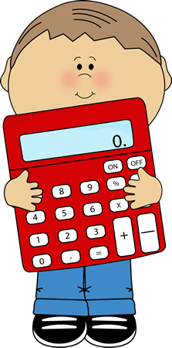
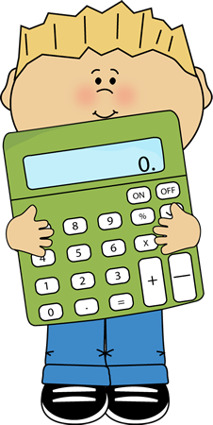
A Really Simple Public Key Cryptosystem
[Ajtai-Dwork 1997, Cohen 2000, R03, Levieil-Naccache 2008]
Private key: a random odd integer s
Public key: a list of random multiples of s plus a small positive even random number
Encrypt 0: add random set of half of them
Encrypt 1: same, but add 1
Decrypt: compute remainder under division by s and check if it’s odd
1001
98100, 65073, 191197,…
289298
Notes:
Bram Cohen, BitTorrent
“Cryptographic Test Correction”, students grade themselves

Slide 10
Progress on provable SVP algs
 | Time | Space
[Kan86]
[AKS01]
[NV08, PS09, MV10a]…
[MV10b] Det
This work
Notes:
Green, Blue, Red. Not mentioning Heuristic! We also have 2^{n/2}…

Slide 11
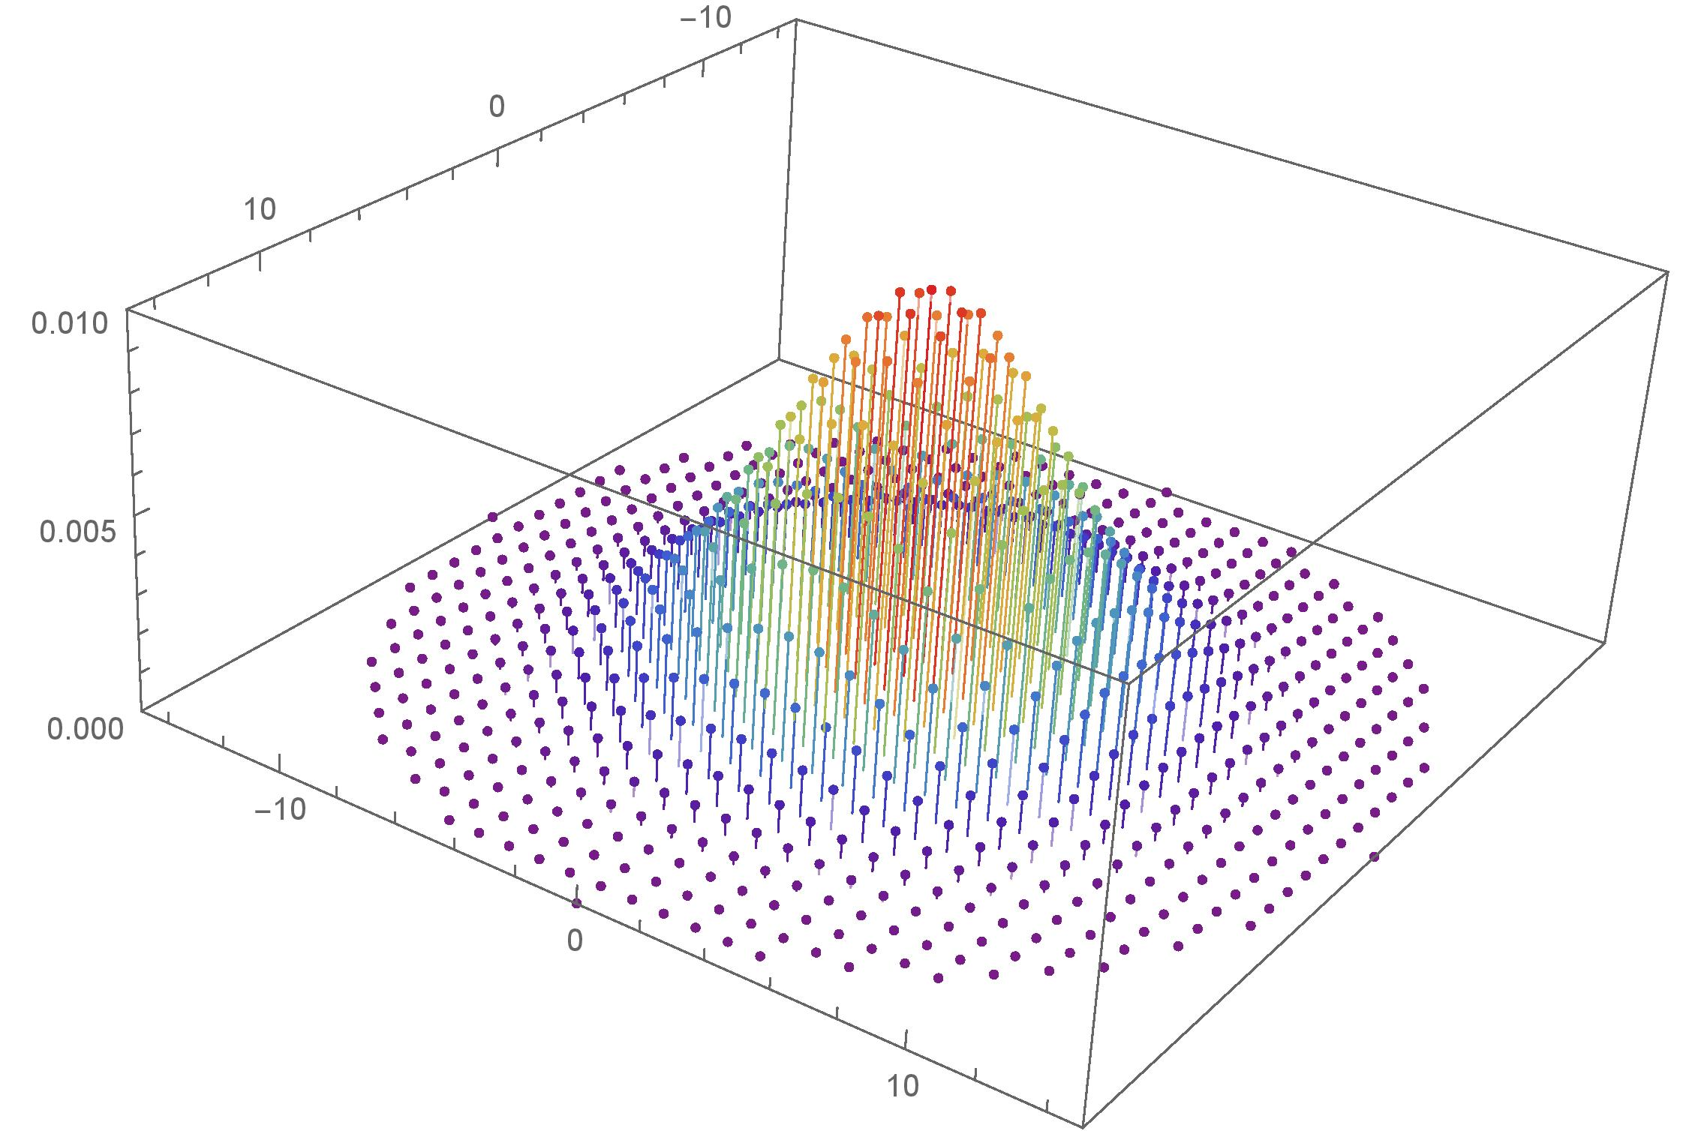
Discrete Gaussian Distribution
Notes:
The protagonist! We’re used to DGS above smoothing, but not below smoothing

Slide 12
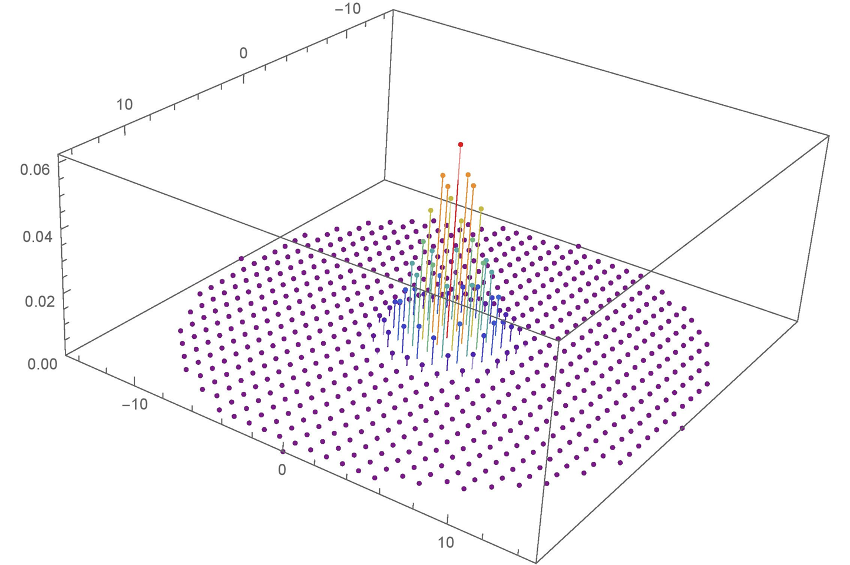
Discrete Gaussian Distribution
If we can obtain discrete Gaussian samples for small enough s, we can solve SVP

Slide 13
Obtaining discrete Gaussian samples
It is easy to obtain samples for large s [GPV08]
Our goal: take samples of width s and output samples with smaller width, say, s/√2
Then we can simply repeat
Naïve attempt: given x output x/2
Problem: x/2 is not in the lattice!
Second naïve attempt: only take x in 2L, and then output x/2
Correct output distribution, but we keep only 2^{-n} of the samples

Slide 14
Obtaining discrete Gaussian samples
A better attempt: partition the samples according to their coset of 2L
Then take two samples from a coset and output their average
Notice that if x,y are in the same coset of 2L, then x+y is in 2L, and so (x+y)/2 is in L
Intuitively, since x and y are Gaussian with s, then x+y is Gaussian with √2·s, and (x+y)/2 is Gaussian with s/√2
But is it distributed correctly?
Notes:
The idea was put forward in about 1970 by Stephen Wiesner, a graduate student at Columbia University,

Slide 15
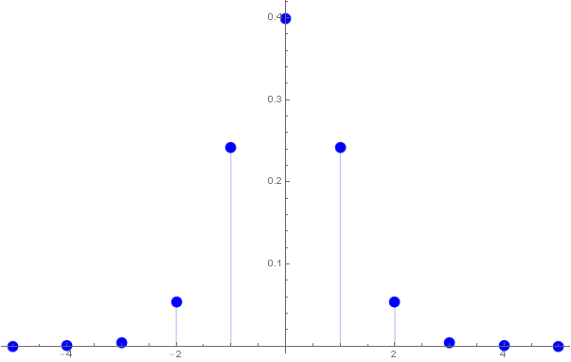
Input Distribution

Slide 16
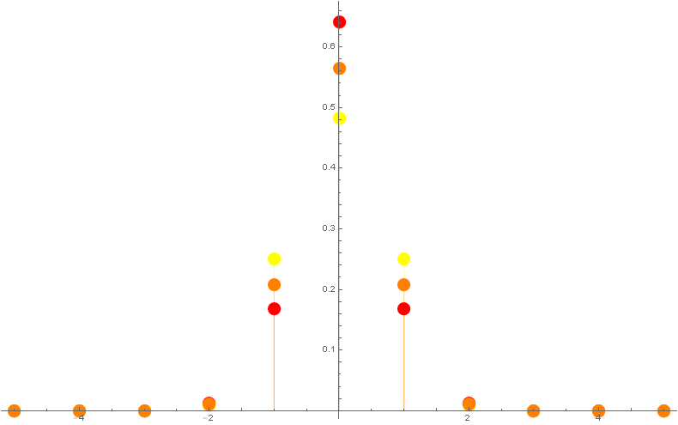
Output Distribution
Red=even
Yellow=odd
Orange=desired

Slide 17
Obtaining discrete Gaussian samples
It turns out that by taking “even” with probability p²_{even} and “odd” with probability p²_{odd} , we get exactly the discrete Gaussian distribution
Proof by picture in the one-dimensional case:
Even
Odd
Notes:
Explain that the distribution over pairs (x,y) that we get is exactly samples from Gaussian distribution over this lattice

Slide 18
Square Sampling
Summary so far:
Bucket the samples into 2^{n} buckets, based on their coset of 2L
Then pick a bucket with probability proportional to square of its probability, and output (x+y)/2 for two vectors in the bucket
For this we use a “square sampling” procedure: given samples from a distribution (p₁,…,p_{N}), output samples from the distribution (p₁²,…,p_{N}²)/∑p_{i}²
We do this using rejection sampling
The loss rate is ∑p_{i}²/p_{max}
Total loss is 2^{n/2} due to magic!
Notes:
NEEDS MORE WORK

Slide 19
Summary
In time 2^{n} we are able to sample from the discrete Gaussian distribution (of any radius)
This implies a 2^{n} time algorithm for SVP
Recent work by my coauthors: also CVP in 2^{n} !
A close inspection of our algorithm shows that 2^{n/2} should be the right answer
So far we are only able to achieve that above smoothing
This implies 2^{n/2} algorithm for O(1)-GapSVP
Puzzle: given coin with unknown heads probability p; output a coin with probability √p
Notes:
The idea was put forward in about 1970 by Stephen Wiesner, a graduate student at Columbia University,

