Slide 1
Practical Applications of
Homomorphic Encryption
Kristin Lauter
Cryptography Research Group
Microsoft Research
Crypto Day 2015
May 13, 2015

Slide 2

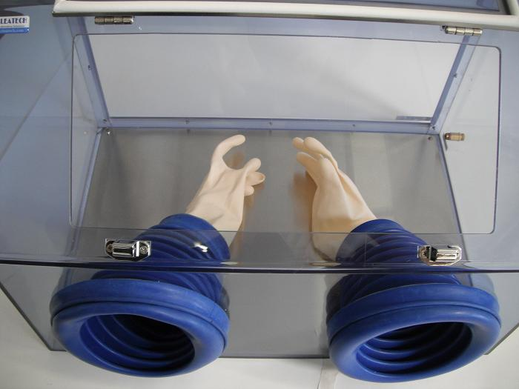
Protecting Data via Encryption:
Homomorphic encryption
Put your gold in a locked box.
Keep the key.
Let your jeweler work on it through a glove box.
Unlock the box when the jeweler is done!

Slide 3
Homomorphic Encryption: addition
a, b
a+ b
compute
encrypt
encrypt
E(a), E(b)
compute
E(a)
E(b)
E(a+b)

Slide 4
Homomorphic Encryption: multiplication
a, b
a x b
compute
encrypt
encrypt
E(a), E(b)
compute
E(a)
E(b)
E(a b)

Slide 5
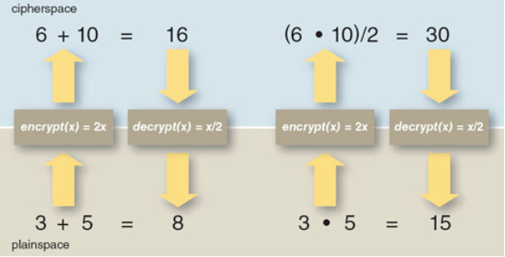
Operating on encrypted data
“Doubly” homomorphic encryption
American Scientist, Sept/Oct 2012

Slide 6
Secure Genome Analysis Competition
iDASH Privacy & Security Workshop 2015
Sponsored by NIH (National Institutes of Health)
Submission deadline: Feb 28 2015
Workshop: March 16, 2015
UCSD Medical Education and Telemedicine Building
Media coverage in GenomeWeb, Donga Science, Nature
Teams from: Microsoft, IBM, Stanford/MIT, UCI, University of Tsukuba
Two Tracks: MPC and HE
Challenges: GWAS and Sequence Alignment

Slide 7
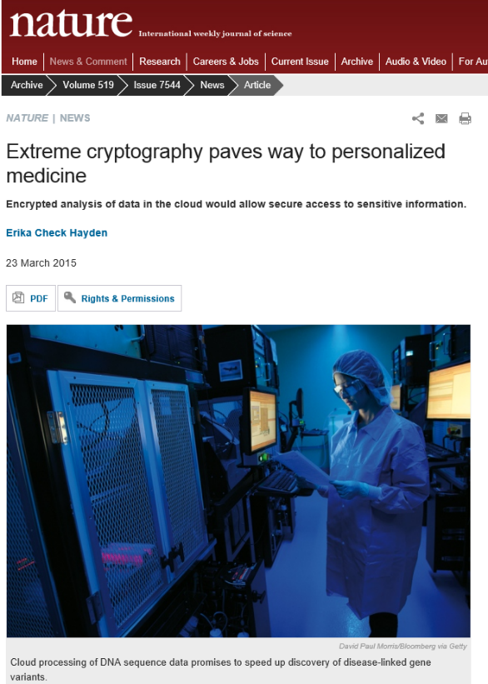
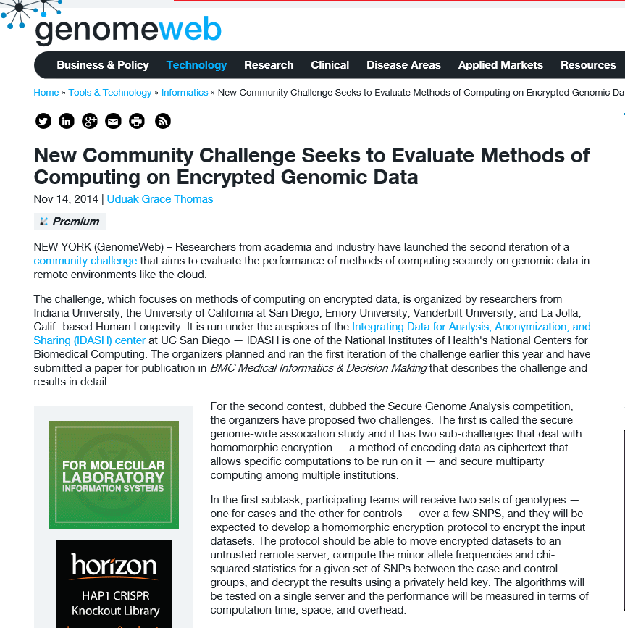

Slide 8
Donga Science, March 13, 2015
○ MS 연구진 이끌고 DNA 보안 알고리즘 개발
이 연구원과 같은 연구실에서 한솥밥을 먹고 있는 김미란 연구원(28)은 생체정보 보안 연구 분야에서 떠오르는 샛별이다. 그는 1월 미국 마이크로소프트(MS) 연구소 초청으로 현지에 급파됐다. 작년 내내 MS 연구진을 이끌고 개발한 DNA 보안 기술이 ‘안전 게놈 분석 경진대회(Secure Genome Analysis Competition)’에 출전했기 때문이다. 이 대회는 샌디에이고 캘리포니아대 의대가 지난해부터 개최하는 첨단 생체정보 보안 대회다.
http://news.donga.com/It/3/all/20150313/70100744/1
GenomeWeb, Nature, …

Slide 9
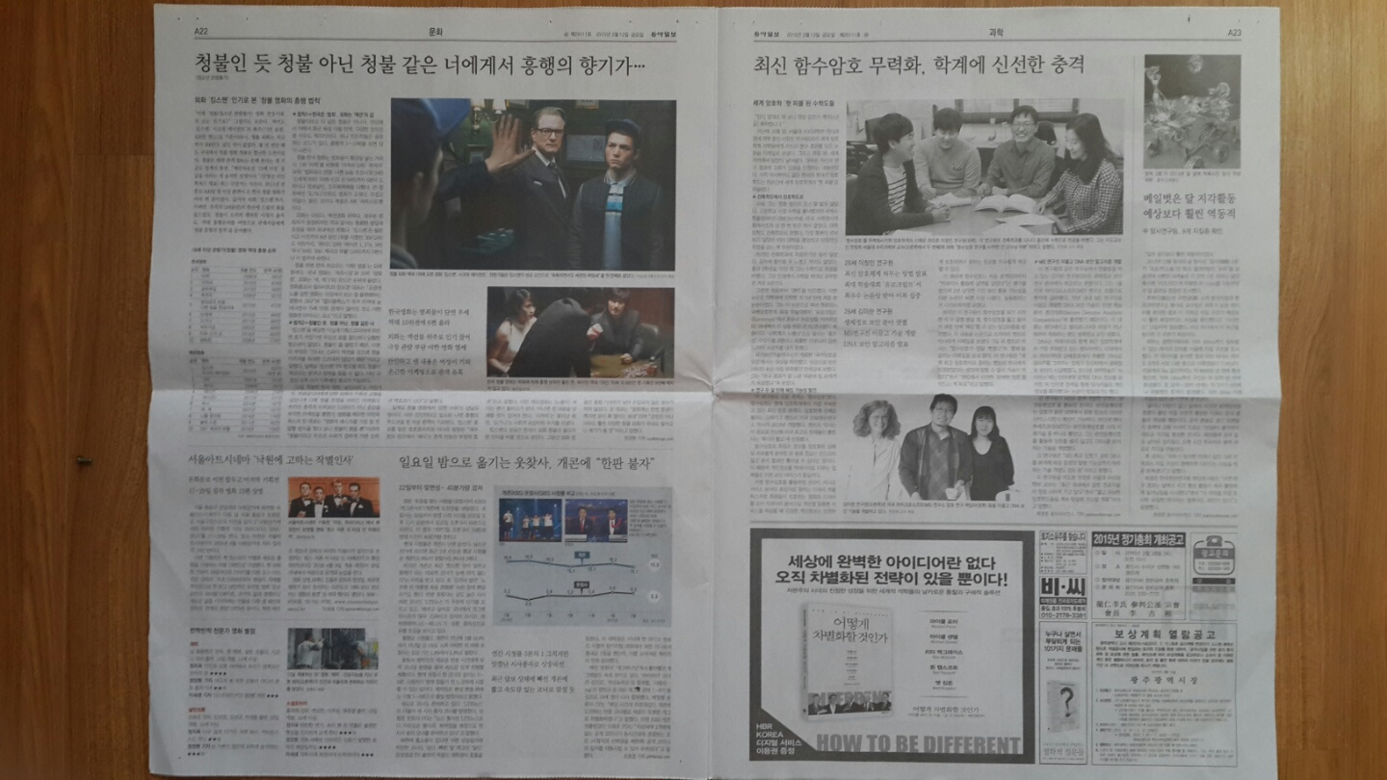

Slide 10
Why the excitement?
Fundamental Problem: privacy protection
  Burgeoning genome sequencing capability
  Explosion of scientific research possible
  High risk for personal privacy
Fundamental Progress through interaction
  Computer Scientists
  Mathematicians
  Bioinformaticians
  Policy-makers

Slide 11
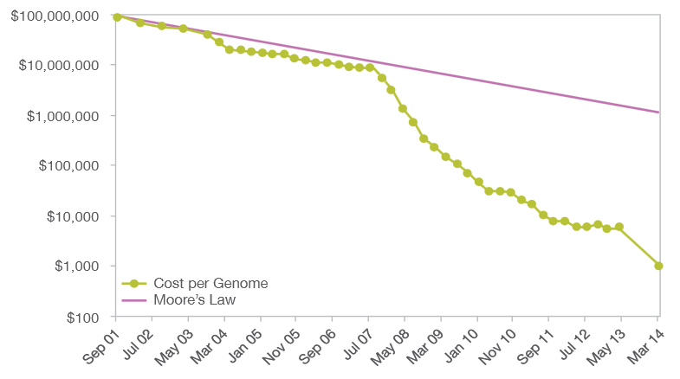
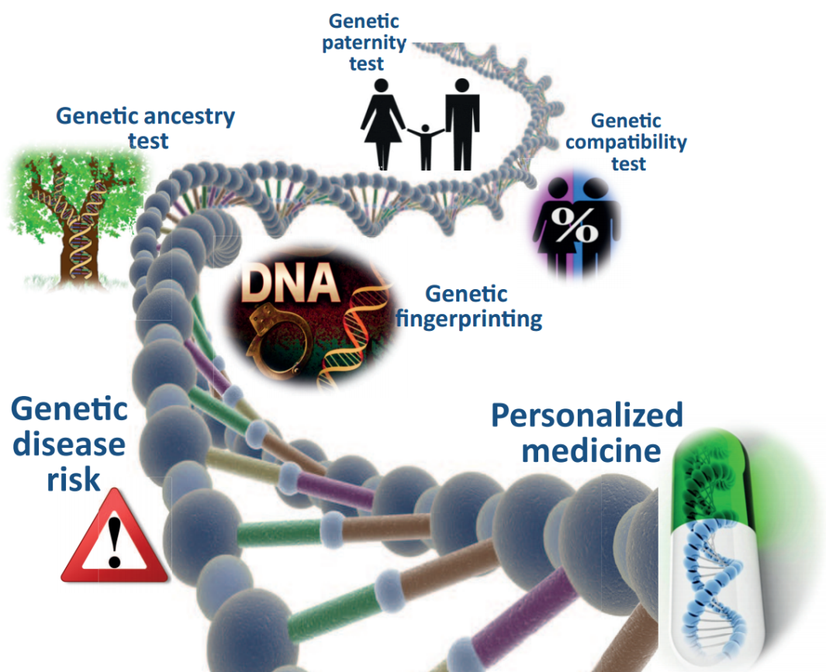
Genomic Revolution
Fast drop in the cost of genome-sequencing
  2000: $3 billion
  Mar. 2014: $1,000
  Genotyping 1M variations: below $200
Unleashing the potential of the technology
  Healthcare: e.g., disease risk detection, personalized medicine
  Biomedical research: e.g., geno-phono association
  Legal and forensic
  DTC: e.g., ancestry test, paternity test
  ……

Slide 12
Genome Privacy
Privacy risks
  Genetic disease disclosure
  Collateral damage
  Genetic discrimination
Grand Challenges:
  How to share genomic data or learning in a way that preserves the privacy of the data donors, without undermining the utility of the data or impeding its convenient dissemination?
  How to perform a LARGE-SCALE, PRIVACY-PRESERVING analysis on genomic data, in an untrusted cloud environment or across multiple users?

Slide 13
Data access and sharing requirements
  Allow access to researchers to large data sets
  Secure Genome Wide Association Studies (GWAS)
  Desire for centrally hosted, curated data
  Provide services based on genomic science discoveries
Two scenarios for interactions:
    Single data owner (one patient, one hospital)
    Multiple data owners (mutually distrusting)

Slide 14
Two Challenges!
Challenge 1:
Homomorphic encryption (HE) based secure genomic data analysis
  Task 1: Secure Outsourcing GWAS
  Task 2: Secure comparison between genomic data
Challenge 2:
Secure multiparty computing (MPC) based secure genomic data analysis
(two institutions)
  Task 1: Secure distributed GWAS
  Task 2: Secure comparison between genomic data

Slide 15
Data Source
200 Cases from Personal Genome Project (PGP)
PGP: http://www.personalgenomes.org/ launched by Harvard Medical School
200 Controls were simulated based on the haplotypes of 174 individuals from population of International HapMap Project (http://hapmap.ncbi.nlm.nih.gov/)
2 individual genomes (hu604D39 with 4,542,542 variations and hu661AD0 with 4,368,847 variations comparing to the reference human genome) were randomly selected from PGP

Slide 16
Results for Task 1.1: Minor Allele Frequency (training dataset with 311 SNPs, time in seconds)
Team | Key Gen | Encryption | Evaluation | Decryption | Total | Memory (MB) | Method
Microsoft | 6.51 | 10.64 | 0.0029 | 0.29 | 17.44 | 118 | RLWE
UCI | 0.20 | 0.34 | 0.0088 | 0.04 | 0.59 | 3.3 | Paillier
Stanford/MIT | 0.53 |  | 0.041 | 0.5 | 1.07 | 8.0 | HMAC-SHA-256
U Tsukuba | 4.28 | 14.42 | 29.16 | 7.35 | 55.21 | 31.8 | RLWE

Slide 17
Results for Task 1.2 (Hamming)
 | Training |  | Testing
 | 5k | 100k | 5k | 10k | 100k
Plaintext data | 4740 | 131535 | 3099 | 3306 | 134252
IBM | 4740 | 131545 | 3099 | 3306 | 134260
Microsoft | 4740 | N/A | 3099 | 3306 | N/A
Stanford/MIT | 4720 | 130035 | 3082 | 3275 | 132703
A C C UR A C Y
 | 5k | 100k | 5k | 10k | 100k
Plaintext data | 0.095s | 1.274s | 0.076s | 0.118s | 1.145s
IBM | 79.0s | 475.2s | 79.4s | 86.8s | 472.2s
Microsoft | 44.019s | N/A | 44.664s | 80.031s | N/A
Stanford/MIT | 20m25s | 1h54m11s | 20m37s | 36m27s | 2h2m26s
T I M E
 | 5k | 100k | 5k | 10k | 100k
Plaintext data | 2.43M | 13.52M | 1.64M | 2.43M | 13.52M
IBM | 1.416G | 2.165G | 1.416G | 1.419G | 2.168G
Microsoft | 513.5M | N/A | 513.7M | 720.5M | N/A
Stanford/MIT | 2.765G | 7.489G | 2.765G | 4.025g | 7.502G
ME MO R Y

Slide 18
Results for Task 1.2
(Approximate Edit distances)
 | Training |  | Testing
 | 5k | 100k | 5k | 10k | 100k
Plaintext data | 7446 | 198705 | 9089 | 16667 | 191986
IBM* | 5777 | 153266 | 5328 | 8318 | 153266
Microsoft | 7446 | N/A | 9089 | 16665 | N/A
A C C U R A C Y
 | 5k | 100k | 5k | 10k | 100k
Plaintext data | 0.103s | 1.489s | 0.106s | 0.144s | 1.528s
IBM* | 96.9s | 552.6s | 91.7s | 106.3s | 555.2s
Microsoft | 92.26s | N/A | 91.09s | 181.92s | N/A
T I M E
 | 5k | 100k | 5k | 10k | 100k
Plaintext data | 2.45M | 25.78M | 2.45M | 2.53M | 25.78M
IBM* | 1.416G | 2.294G | 1.418G | 1.451G | 2.295G
Microsoft | 701.1M | N/A | 700.8M | 1.295G | N/A
M E M O R Y
*An approximate algorithm (with about 22% error), which was not considered in the competition.

Slide 19
Winners
Task 1.1: Stanford/MIT
Task 1.2: Hamming distance: IBM
Task 1.2: Approximate Edit distance: Microsoft

Slide 20
Practical problems:
Cleaning/curating data
Encoding data
Trade-offs in computation time vs. memory
Parameter selection: challenging to optimize and automate

Slide 21
Follow-up
Report to NIH
Special Issue in Biomedical Informatics and Medical Decision-making
  Papers from each team describing their submissions

Slide 22
What scenarios make sense for HE?
Private, personalized cloud services
  Ideally combined with storage, or asynchronized access
Multiple parties upload data, only designated parties access results
Long-term storage is desirable
Cryptographic Cloud Services
  Hosted enterprise scenarios for storage and computation

Slide 23
Scenarios: Private cloud services
  Direct-to-patient services
    Personalized medicine
    DNA sequence analysis
    Disease prediction
  Hosted databases for enterprise
    Hospitals, clinics, companies
    Allows for third party interaction

Slide 24
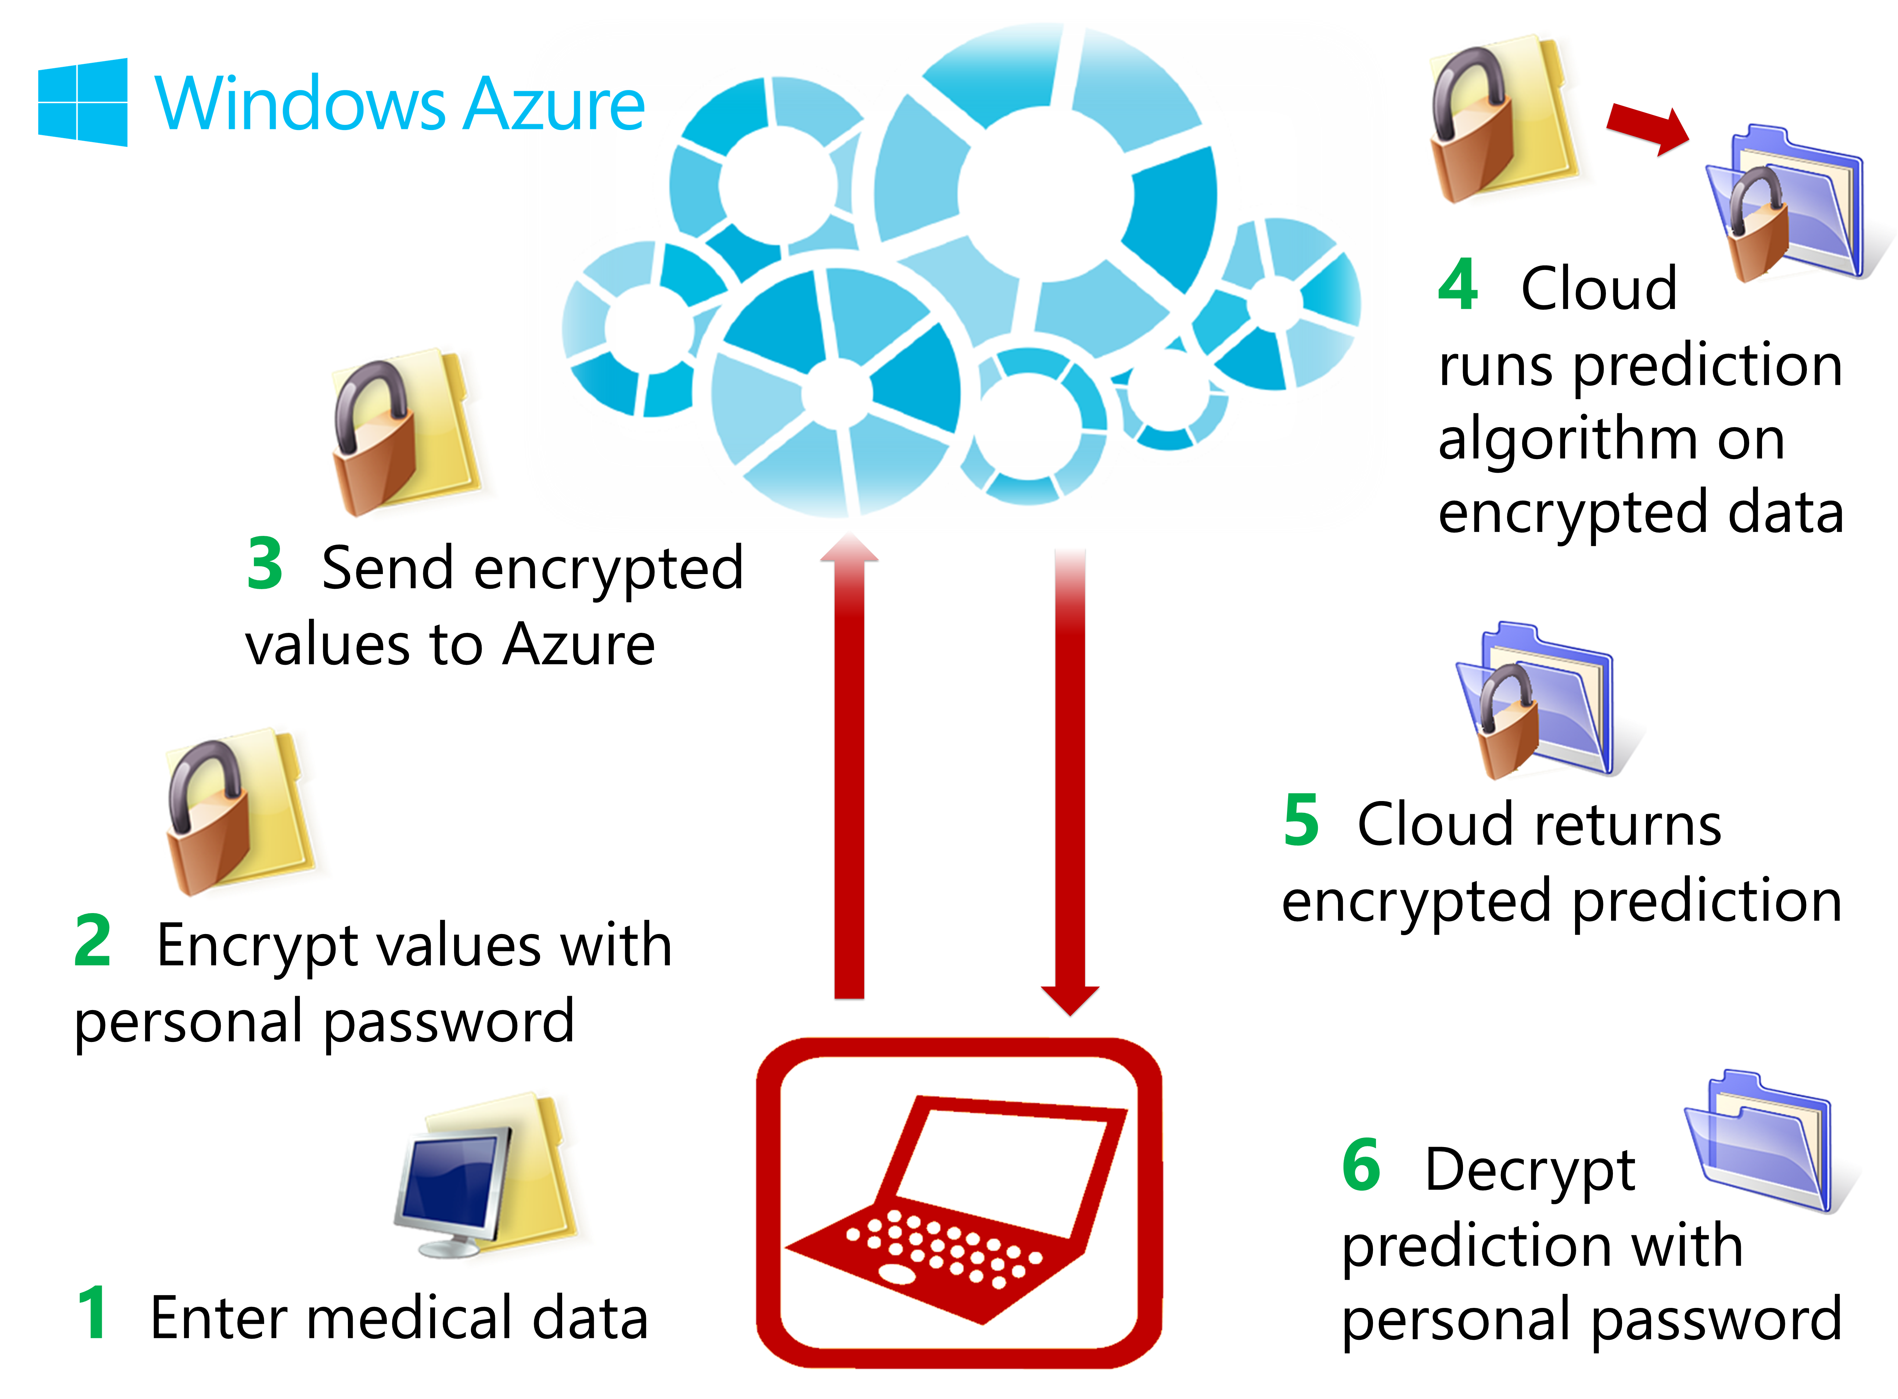
Outsourcing computation

Slide 25
Demo: Will you have a heart attack?
Online service running in Windows Azure
Patient enters personal info on local machine:
  weight, age, height, blood pressure, body mass index
Data is encrypted on local machine
Encrypted data is sent to the cloud
Value of prediction function is computed on encrypted data
Encrypted result is sent back to the patient
Patient enters key to decrypt answer.
Evaluation takes 0.2 seconds in the cloud!

Slide 26
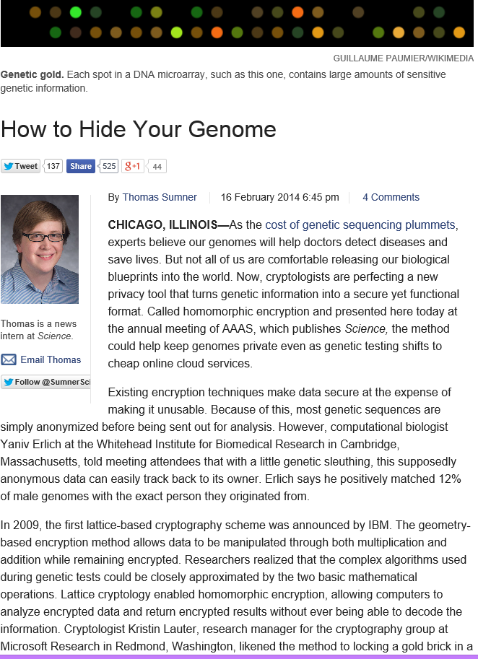
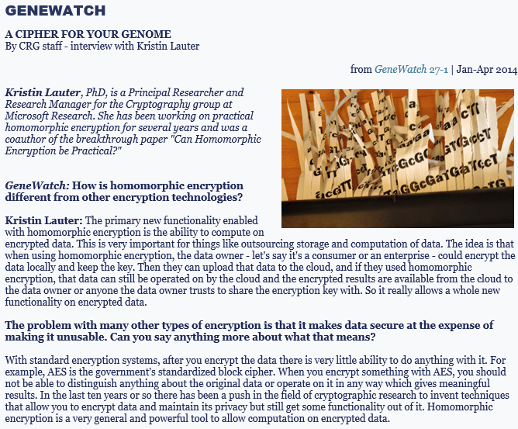

Slide 27

Processing of encrypted medical data
Health monitor
Health monitor
Lab results
All data uploaded to the server encrypted under Alice’s public or private key
Cloud operates on encrypted data and returns encrypted predictive results

Slide 28







Scenario for genomic data
Untrusted cloud service
Stores, computes on encrypted data
Trusted party
hosts data and regulates access
Researcher:
requests encrypted
results of specific computations
Requests for decryption of results (requires a policy)
Notes:
Pairings in BGN.
Note on bit encryption!
For doing 1 block only, fastest implementation could handle 54 blocks in parallel, about 40 minutes per block.
Can do an implementation with 720 blocks in parallel, about 5 minutes per block.

Slide 29
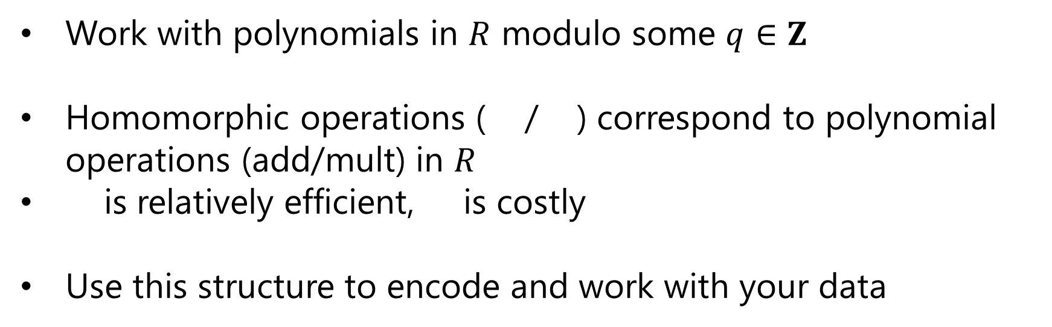

Homomorphic Encryption from RLWE
Uses polynomial rings as plaintext and ciphertext spaces
$R=Z\left[X\right]/(X^{n}+1), n=2^{k}$
Work with polynomials in $R$ modulo some $q∈Z$
Homomorphic operations ( / ) correspond to polynomial operations (add/mult) in $R$
is relatively efficient, is costly
Use this structure to encode and work with your data
Notes:
Pairings in BGN.
Note on bit encryption!
For doing 1 block only, fastest implementation could handle 54 blocks in parallel, about 40 minutes per block.
Can do an implementation with 720 blocks in parallel, about 5 minutes per block.

Slide 30
What kinds of computation?
Building predictive models
Predictive analysis
  Classification tasks
  Disease prediction
  Sequence matching
Data quality testing
Basic statistical functions
Statistical computations on genomic data

Slide 31
Functions to compute
Average, Standard deviation, Chi-squared, …
Logistical regression: the prediction is
f(x) = e^{x}/(1+e^{x})
      where x is the sum of α_{i} x_{i}, where α_{i} is the weighting constant or regression coefficient for the variable x_{i}

Slide 32
Machine Learning for Predictive Modeling
Supervised Learning
  Goal: derive a function from labeled training data
  Outcome: use the “learned” function to give a prediction (label) on new data
  Training data represented as vectors.

Slide 33
Linear Means Classifier (binary)
Divide training data into (two) classes according to their label
Compute mean vectors for each class
Compute difference between means
Compute the midpoint
Define a hyperplane between the means, separating the two classes

Slide 34
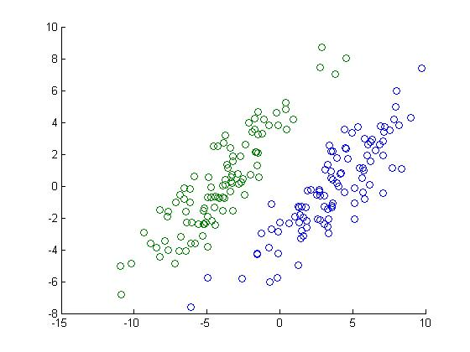
Binary classification example
FDA data set

Slide 35
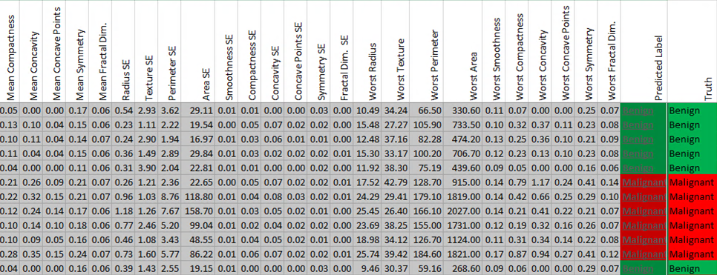
Predictions on Medical data
Tumor measurements: Benign or Malignant

Slide 36
Machine Learning on Encrypted Data
Implements Polynomial Machine Learning Algorithms
Integer Algorithms
Division-Free Linear Means Classifier (DFI-LM)
Fisher’s Linear Discriminant Classifier

Slide 37
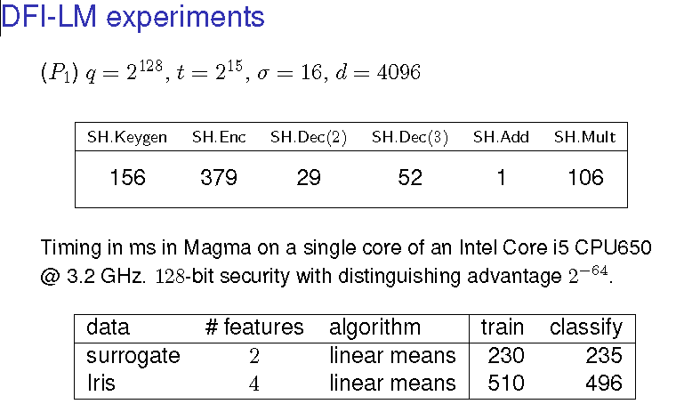

Slide 38
Statistics on Genomic Data
  Pearson Goodness-Of-Fit Test
    checks data for bias (Hardy-Weinberg equilibrium)
  Cochran-Armitage Test for Trend
    Determine correlation between genome and traits
  Linkage Disequilibrium Statistic
    Estimates correlations between genes
    Estimation Maximization (EM) algorithm for haplotyping

Slide 39
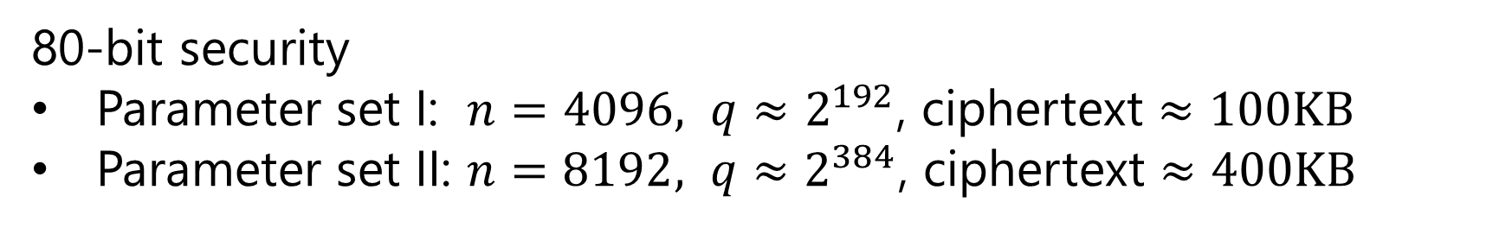
Genomic algorithm performance
80-bit security
Parameter set I: $n=4096, q≈2^{192}$, ciphertext $≈100KB$
Parameter set II: $n=8192, q≈2^{384}$, ciphertext $≈400KB$
Algorithm | Pearson | EM (iterations) |  |  | LD | CATT
 |  | 1 | 2 | 3
Parameters I | 0.3s | 0.6s | 1.1s | - | 0.2s | 1.0s
Parameters II | 1.4s | 2.3s | 4.5s | 6.9s | 0.7s | 3.6s
Proof-of-concept implementation: computer algebra system Magma,
Intel Core i7 @ 3.1GHz, 64-bit Windows 8.1
Notes:
Pairings in BGN.
Note on bit encryption!
For doing 1 block only, fastest implementation could handle 54 blocks in parallel, about 40 minutes per block.
Can do an implementation with 720 blocks in parallel, about 5 minutes per block.

Slide 40
What enables these performance numbers?
Ring-LWE based schemes ([LPR,BV,BGV, SV, GHS, SS, BLLN]) with clever data encoding techniques
Comparable performance:
Helib (open source library from IBM)
Halevi-Shoup, Smart, Vercauteren, Gentry
Encryption scheme: BGV
General cyclotomic rings
Ciphertext packing
Modulus switching
Implemented without bootstrapping
ARITH (internal Microsoft Research library)
Bos-Naehrig, Kim, L, Loftus
Encryption scheme: BLLN
2-power cyclotomic rings
Ciphertext packing with t ≠ 2
Scale invariant
No bootstrapping
Can even avoid relinearization

Slide 41
Practical Homomorphic Encryption
do not need *fully* homomorphic encryption
“somewhat” does not mean *partially*
encode integer information as “integers”
several orders of magnitude speed-up
do not need deep circuits to do a single multiplication
do not need boot-strapping
for “logical” circuits, use ciphertext packing and tradeoff depth for ciphertext size
need to set parameters to ensure correctness and security
PHE=homomorphic for any fixed circuit size, with correctly chosen parameters

Slide 42
Performance Summary
Data quality (Pearson Goodness-of-Fit)
~ 0.3 seconds, 1,000 patients
Predicting Heart Attack (Logistic Regression)
~ 0.2 seconds
Building models (Linear Means Classifier)
~0.9 secs train, classify: 30 features, 100 training samples
Sequence matching (Edit distance)
~27 seconds amortized, length 8
Core i7 3.4GHz
80-bit security

Slide 43
What are the Costs? Challenges? Obstacles?
For homomorphic encryption
  Storage costs (large ciphertexts)
  New hard problems (introduced 2010-2015)
  Efficiency at scale (large amounts of data, deep circuits)
For Garbled Circuits
  High interaction costs
  Bandwidth use
  Integrate with storage solutions

Slide 44
Challenges for the future:
Public Databases: multiple patients under different keys
More efficient encryption at scale
Integrate with other crypto solutions
Expand functionality
Attack underlying hard problems

Slide 45
Joint work with:
…and thanks to iDASH and co-authors for selected slides…
Can Homomorphic Encryption be Practical?
Kristin Lauter, Michael Naehrig, Vinod Vaikuntanathan, CCSW 2011
ML Confidential: Machine Learning on Encrypted Data
Thore Graepel, Kristin Lauter, Michael Naehrig, ICISC 2012
Predictive Analysis on Encrypted Medical Data
Joppe W. Bos, Kristin Lauter, and Michael Naehrig, Journal of Biomedical Informatics, 2014.
Private Computation on Encrypted Genomic Data
Kristin Lauter, Adriana Lopez-Alt, Michael Naehrig, GenoPri2014, LatinCrypt2014.
Homomorphic Computation of Edit Distance
Jung Hee Cheon, Miran Kim, Kristin Lauter, WAHC, FC 2015

