Slide 1
Fearful Symmetry:
Can We Solve Ideal Lattice Problems Efficiently?
Craig Gentry
IBM T.J. Watson
Workshop on Lattices with Symmetry

Slide 2
Can we efficiently break lattices with certain types of symmetry?
Can we break “ideal lattices” – lattices for ideals in number fields – by combining geometry with algebra?
If a lattice has an orthonormal basis, can we find it?

Slide 3
Gentry-Szydlo Algorithm
Combines geometric and algebraic techniques
to break some lattices with symmetry.
Suppose L is a “circulant” lattice with a circulant basis B.
Given any basis of L:
If B’s vectors are orthogonal, we can find B in poly time!
If we are given precise info about B’s “shape” (but not its “orientation”) we can find B in poly time.

Slide 4
Gentry-Szydlo Algorithm
Combines geometric and algebraic techniques
to break some lattices with symmetry.
Suppose I = (v) is a principal ideal in a cyclotomic field.
Given any basis of the ideal lattice associated to I:
If v times its conjugate is 1, we can find v in poly time!
Given v times its conjugate, we can find v in poly time.

Slide 5
Overview
Cryptanalysis of early version of NTRUSign
  Some failed attempts
  GS attack, including the “GS algorithm”
Thoughts on extensions/applications of GS

Slide 6
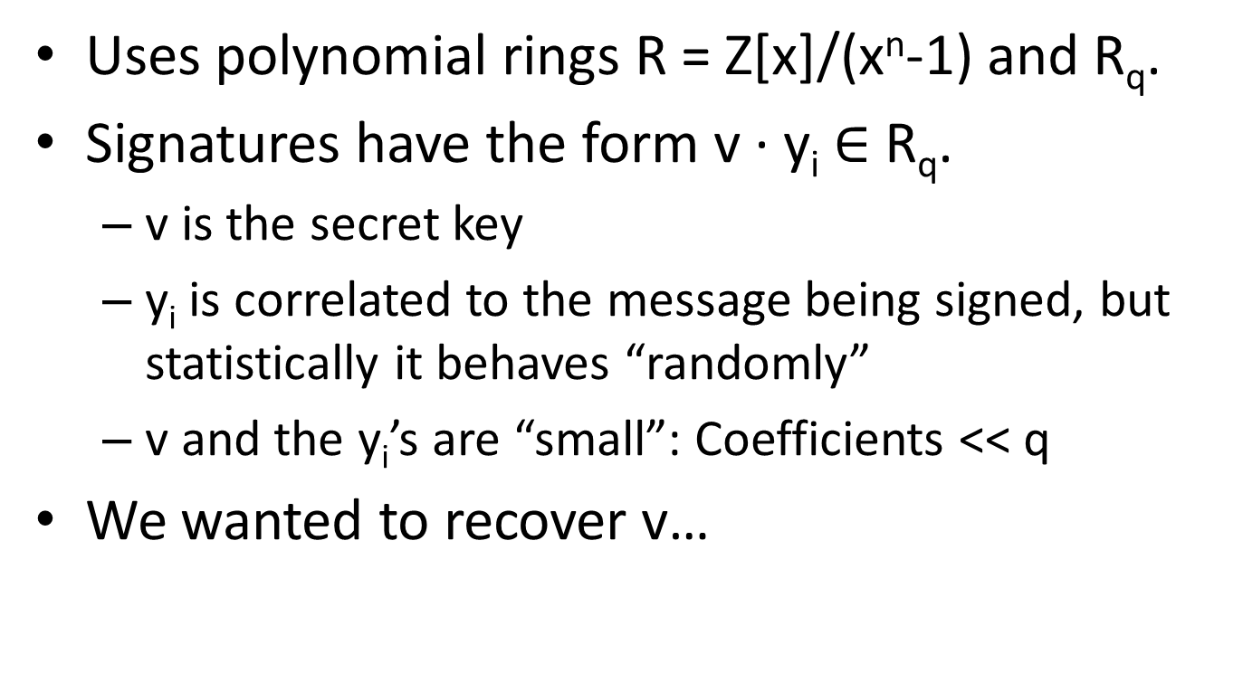
Early version of NTRUSign
Uses polynomial rings R = Z[x]/(x^{n}-1) and R_{q}.
Signatures have the form v · y_{i} $∈$ R_{q}.
  v is the secret key
  y_{i} is correlated to the message being signed, but statistically it behaves “randomly”
  v and the y_{i}’s are “small”: Coefficients << q
We wanted to recover v…

Slide 7
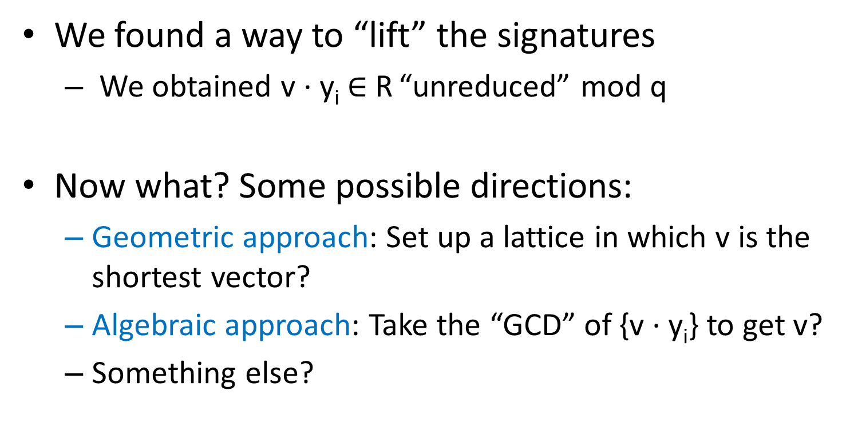
How to Attack it?
We found a way to “lift” the signatures
  We obtained v · y_{i} $∈$ R “unreduced” mod q
Now what? Some possible directions:
  Geometric approach: Set up a lattice in which v is the shortest vector?
  Algebraic approach: Take the “GCD” of {v · y_{i}} to get v?
  Something else?

Slide 8
Adventures in Cryptanalysis:
A Standard Lattice Attack

Slide 9
Lattices
Lattice: a discrete additive subgroup of R^{n}

Slide 10
Lattices
b₁
b₂
Basis of lattice: a set of linearly independent vectors that generate the lattice

Slide 11
Lattices
b₁
b₂
Basis of lattice: a set of linearly independent vectors that generate the lattice

Slide 12
Lattices
b₁
b₂
Basis of lattice: a set of linearly independent vectors that generate the lattice

Slide 13
Lattices
b₁
b₂
Basis of lattice: a set of linearly independent vectors that generate the lattice

Slide 14
Lattices
b₁
b₂
Basis of lattice: a set of linearly independent vectors that generate the lattice
Different bases → same parallelepiped volume (determinant)

Slide 15
Lattices
b₁
b₂
Basis of lattice: a set of linearly independent vectors that generate the lattice
Different bases → same parallelepiped volume (determinant)

Slide 16
Hard Problems on Lattices
b₁
b₂
Given “bad” basis B of L:

Slide 17
Hard Problems on Lattices
b₁
b₂
Given “bad” basis B of L:
Shortest vector problem (SVP):
Find the shortest nonzero vector in L

Slide 18
Hard Problems on Lattices
b₁
b₂
Given “bad” basis B of L:
Shortest independent vector problem (SIVP):
Find the shortest set of n linearly independent vectors

Slide 19
Hard Problems on Lattices
b₁
b₂
v
Given “bad” basis B of L:
Closest vector problem (CVP):
Find the closest L-vector to v

Slide 20
Hard Problems on Lattices
b₁
b₂
v
Given “bad” basis B of L:
Bounded distance decoding (BDDP):
Output closest L-vector to v, given that it is very close

Slide 21
Hard Problems on Lattices
b₁
b₂
Given “bad” basis B of L:
γ-Approximate SVP
Find a vector at most γ times as long as the shortest nonzero vector in L

Slide 22
Canonical Bad Basis:
Hermite Normal Form
Every lattice L has a canonical basis B = HNF(L). Some properties:
Upper triangular
Diagonal entries B_{i,i} are positive
For j < i, B_{j,i} < B_{i,i} (entries of above the diagonal are smaller)
Compact representation: HNF(L) expressible in O(n log d) bits, where d is the absolute value of the determinant of (any) basis of L.
Efficiently computable: from any other basis, using techniques similar to Gaussian elimination.
The “baddest basis”: HNF(L) “reveals no more” about structure of L than any other basis.

Slide 23
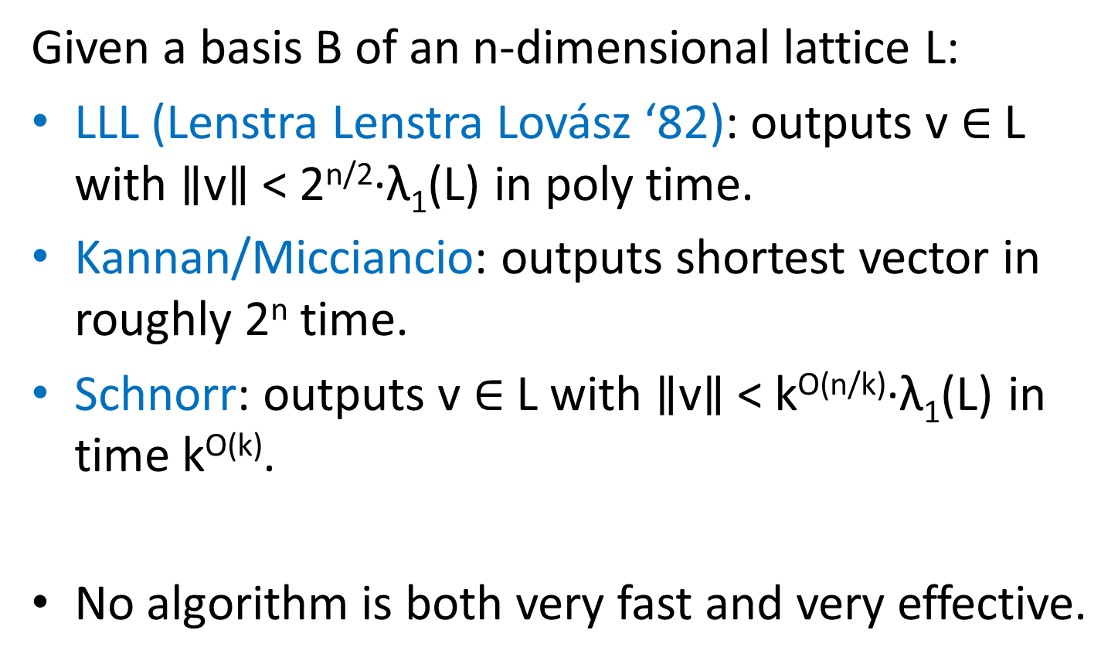
Lattice Reduction Algorithms
Given a basis B of an n-dimensional lattice L:
LLL (Lenstra Lenstra Lovász ‘82): outputs v $∈$L with $∥$v$∥$< 2^{n/2}·λ₁(L) in poly time.
Kannan/Micciancio: outputs shortest vector in roughly 2^{n} time.
Schnorr: outputs v $∈$L with $∥$v$∥$< k^{O(n/k)}·λ₁(L) in time k^{O(k)}.
No algorithm is both very fast and very effective.

Slide 24
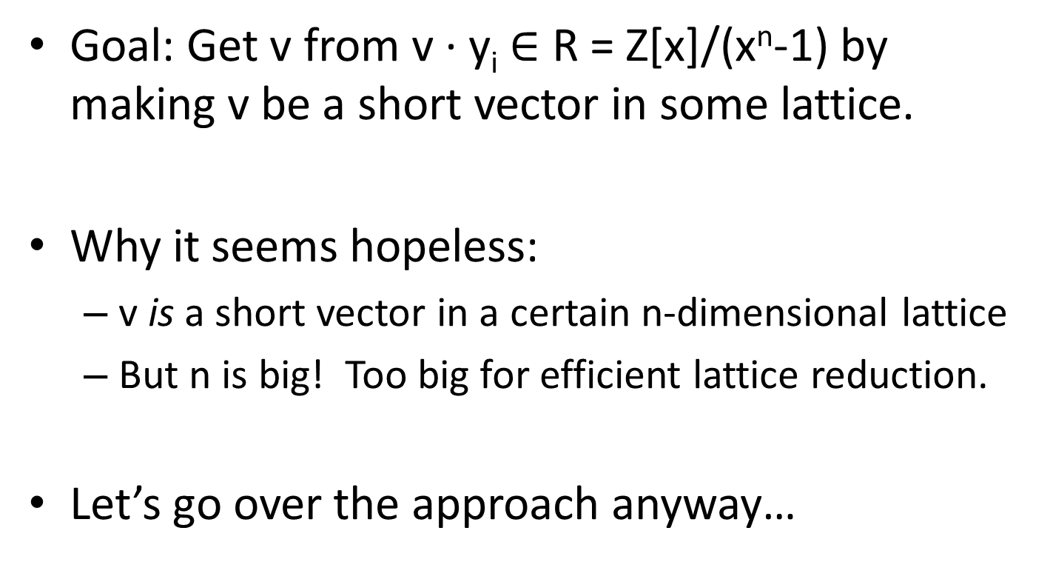
Back to Our Cryptanalysis…
Goal: Get v from v · y_{i} $∈$ R = Z[x]/(x^{n}-1) by making v be a short vector in some lattice.
Why it seems hopeless:
  v is a short vector in a certain n-dimensional lattice
  But n is big! Too big for efficient lattice reduction.
Let’s go over the approach anyway…

Slide 25
Lattice of Multiples of v(x)
Let L = lattice generated by our v(x)·y_{i}(x) sigs.
  L likely contains all multiples of v(x).
  If so, v(x) is a short(est) vector in L.
Can we reduce L? What is L’s dimension? Does it have structure we can exploit?

Slide 26
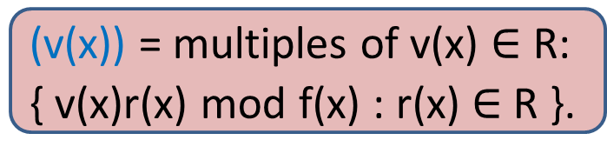
Ideal Lattices
Definition of an ideal of a ring R
  I is a subset of R
  I is additively closed (basically, a lattice)
  I is closed under multiplication with elements of R
(3) = polynomials in R that are divisible by 3
(v(x)) = multiples of v(x) $∈$R:
{ v(x)r(x) mod f(x) : r(x) $∈$ R }.
Ideal lattice: a representation of an ideal as a free Z-module (a lattice) of rank n generated by some n-dimensional basis B.

Slide 27
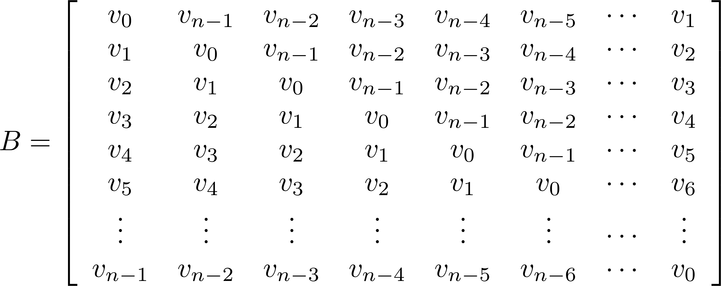
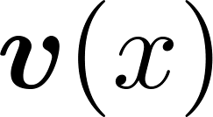
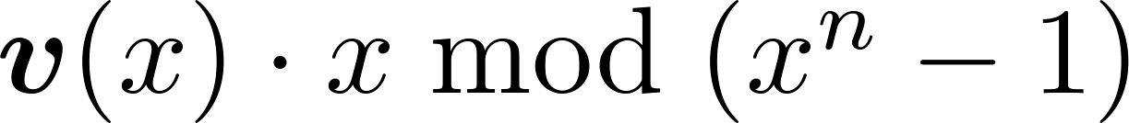
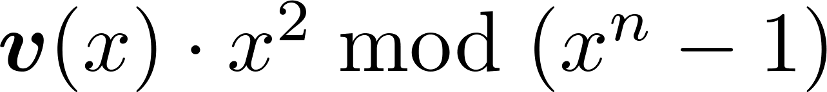
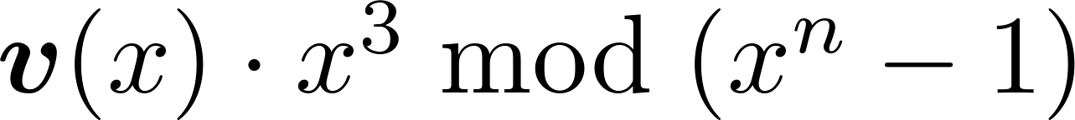


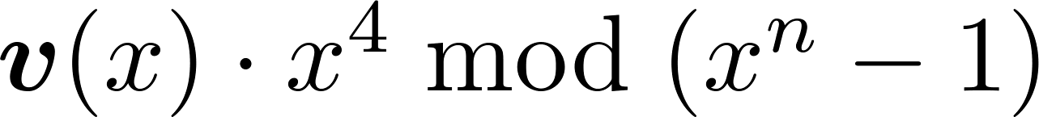
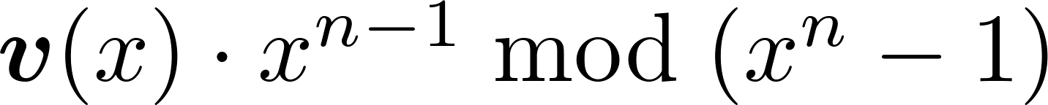
Circulant Lattices and Polynomials
Rotation basis of v(x) generates ideal lattice I = (v)
Computing B·w is like computing v(x)·w(x)

Slide 28
Why Lattice Reduction Fails Here
v’s ideal lattice has dimension n.
The lattice has lots of structure
  An underlying circulant “rotation” basis
  But lattice reduction algorithms don’t exploit it.

Slide 29
Adventures in Cryptanalysis:
An Algebraic Failure

Slide 30
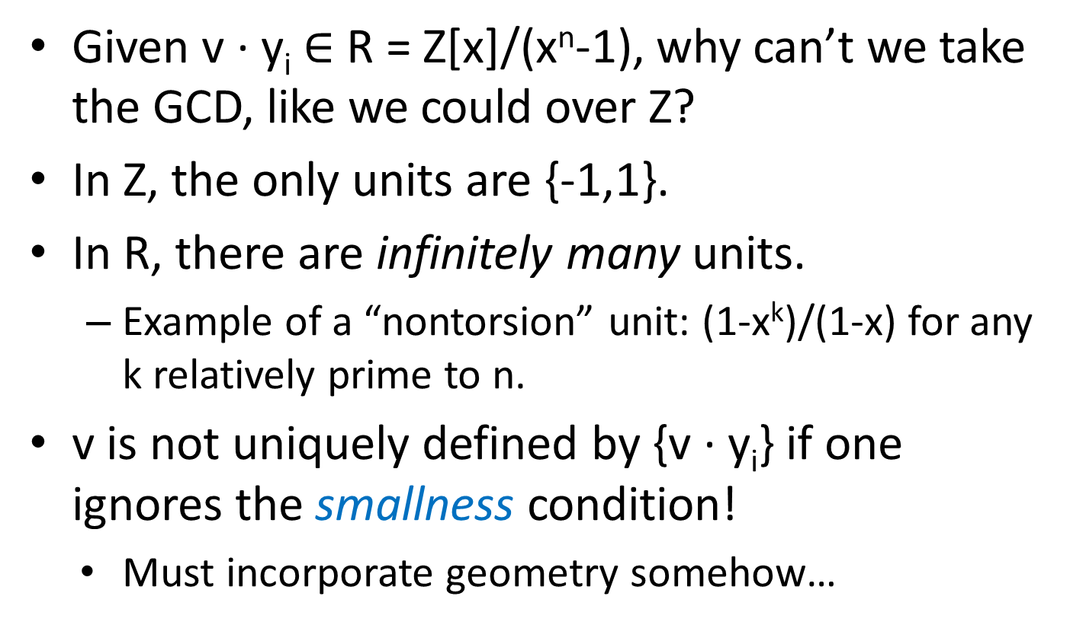
Why Can’t We Take the GCD?
Given v · y_{i} $∈$ R = Z[x]/(x^{n}-1), why can’t we take the GCD, like we could over Z?
In Z, the only units are {-1,1}.
In R, there are infinitely many units.
  Example of a “nontorsion” unit: (1-x^{k})/(1-x) for any k relatively prime to n.
  v is not uniquely defined by {v · y_{i}} if one ignores the smallness condition!
    Must incorporate geometry somehow…

Slide 31
Adventures in Cryptanalysis:
Let’s get to the successes…

Slide 32
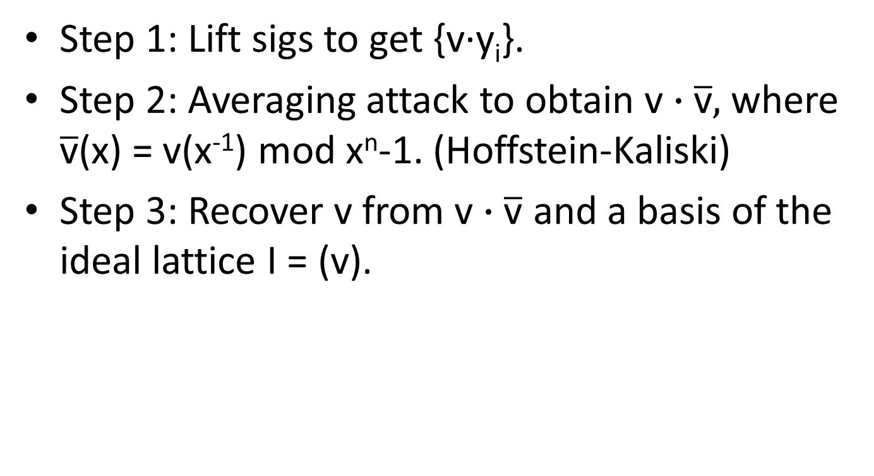
Gentry-Szydlo Attack
Step 1: Lift sigs to get {v·y_{i}}.
Step 2: Averaging attack to obtain $\text{v}∙\overline{\text{v}},$where $\overline{\text{v}}$(x) = v(x⁻¹) mod x^{n}-1. (Hoffstein-Kaliski)
Step 3: Recover v from $\text{v}∙\overline{\text{v}}$ and a basis of the ideal lattice I = (v).

Slide 33
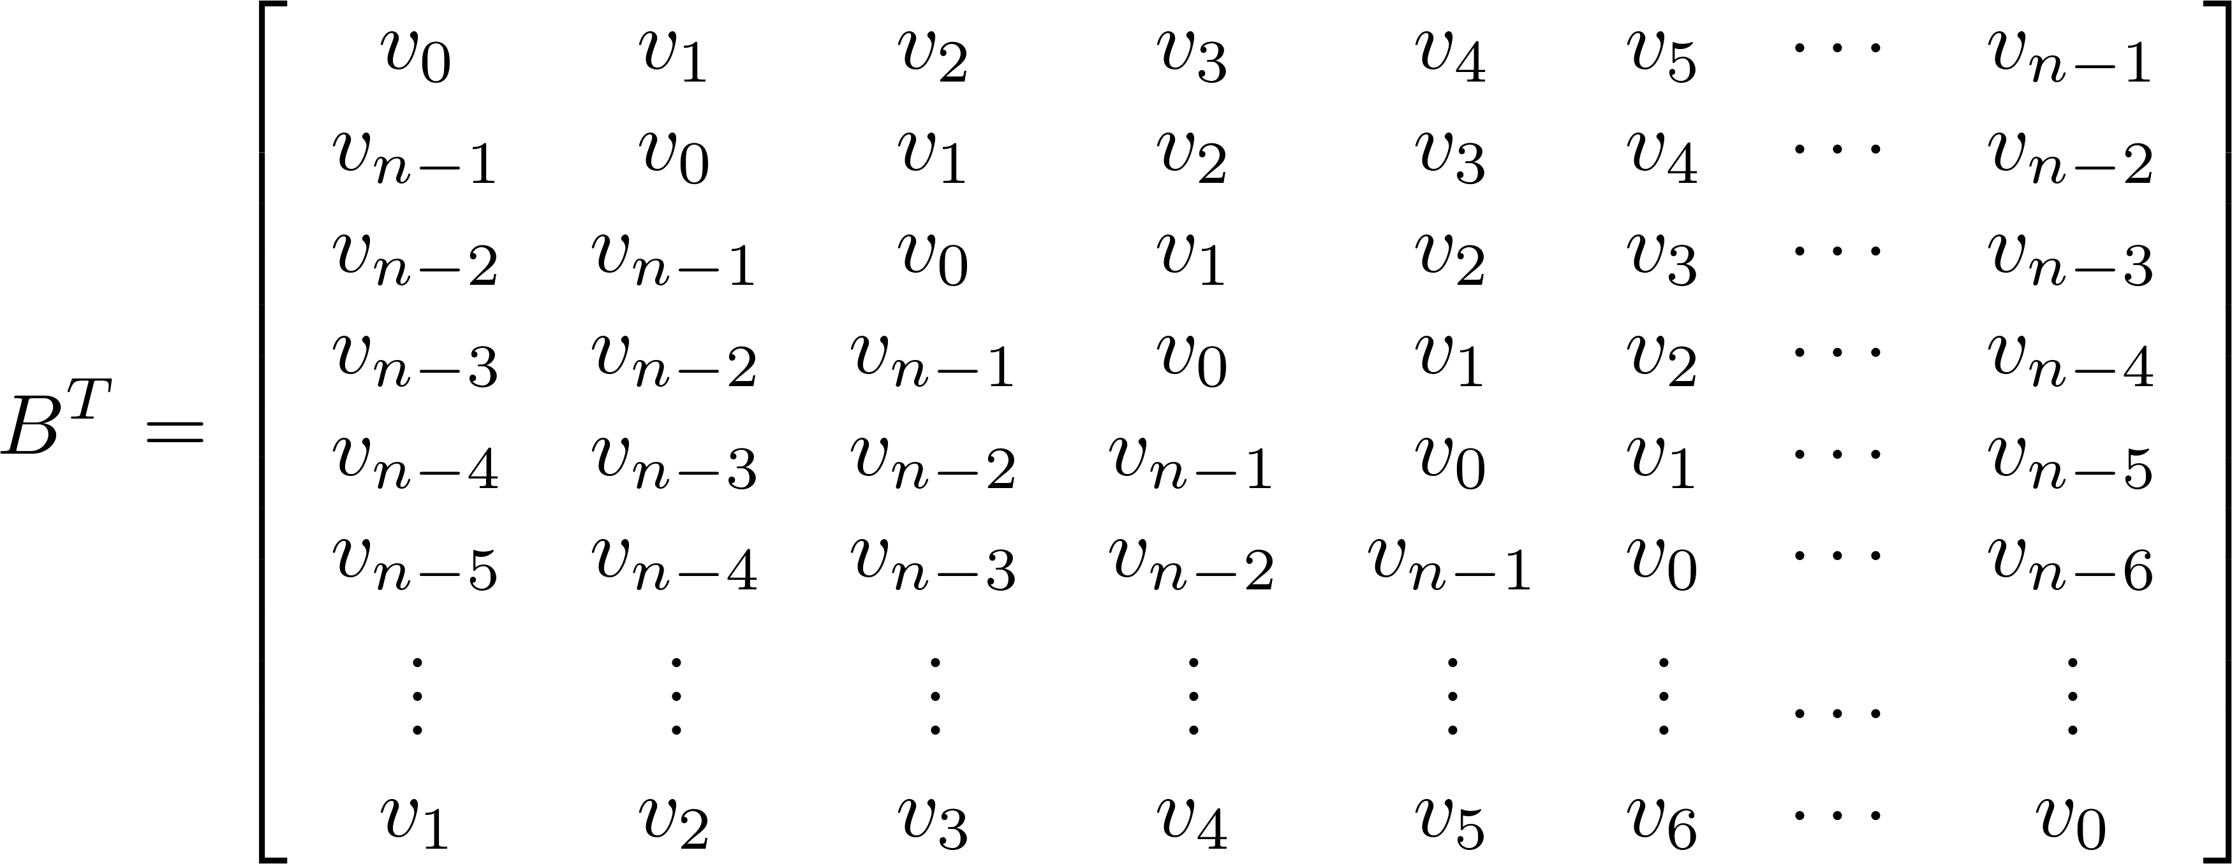

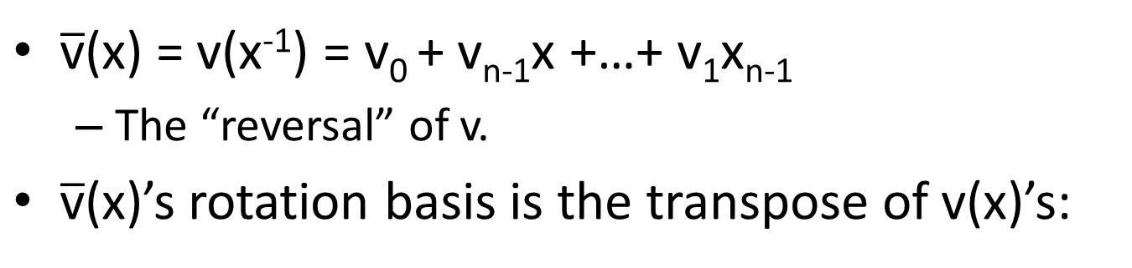
What is this thing $\text{v}∙\overline{\text{v}}?$
$\overline{\text{v}}$(x) = v(x⁻¹) = v₀ + v_{n-1}x +…+ v₁x_{n-1}
  The “reversal” of v.
$\overline{\text{v}}$(x)’s rotation basis is the transpose of v(x)’s:

Slide 34
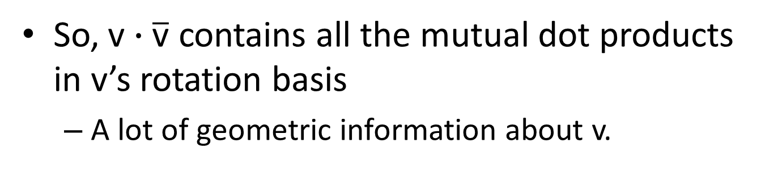
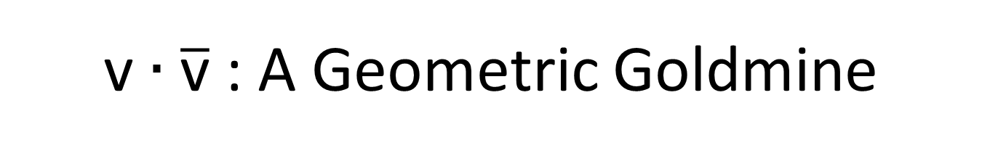
$\text{v}∙\overline{\text{v}}$ : A Geometric Goldmine
$\text{v}∙\overline{\text{v}}$’s rotation basis is B·B^{T}, the Gram matrix of B!
So, $\text{v}∙\overline{\text{v}}$ contains all the mutual dot products in v’s rotation basis
  A lot of geometric information about v.

Slide 35
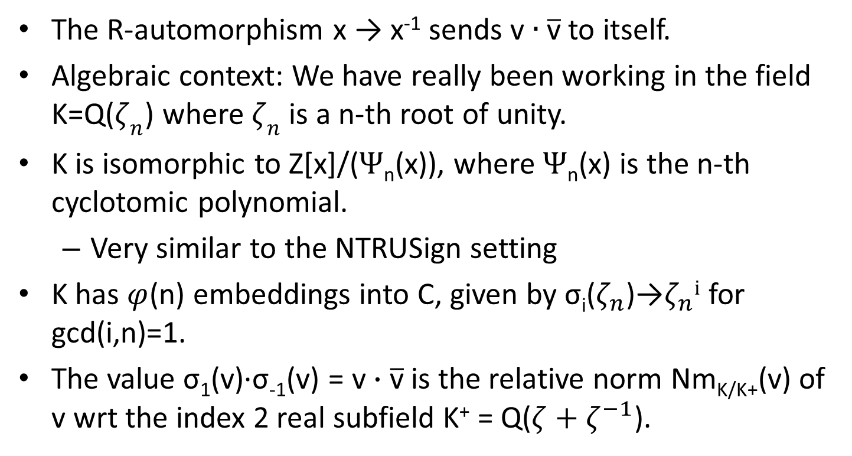
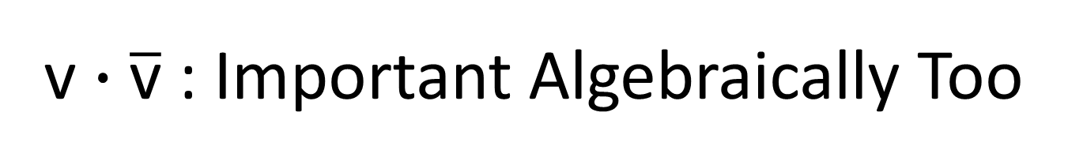
$\text{v}∙\overline{\text{v}}$ : Important Algebraically Too
The R-automorphism x → x⁻¹ sends $\text{v}∙\overline{\text{v}}$ to itself.
Algebraic context: We have really been working in the field K=Q($ζ_{n}$) where $ζ_{n}$ is a n-th root of unity.
K is isomorphic to Z[x]/($Ψ$_{n}(x)), where $Ψ$_{n}(x) is the n-th cyclotomic polynomial.
  Very similar to the NTRUSign setting
K has $φ$(n) embeddings into C, given by σ_{i}($ζ_{n}$)→$ζ_{n}i$ for gcd(i,n)=1.
The value σ₁(v)·σ₋₁(v) = $\text{v}∙\overline{\text{v}}$ is the relative norm Nm_{K/K+}(v) of v wrt the index 2 real subfield K⁺ = Q($ζ+ζ^{−1}$).

Slide 36
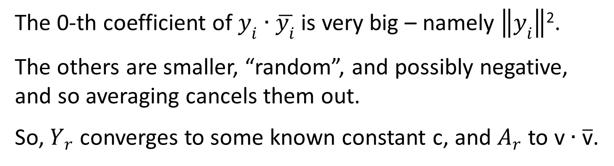
Averaging Attack
Consider the average:
The 0-th coefficient of $y_{i}$ $∙\overline{y_{i}}$ is very big – namely $\left\|y_{i}\right\|$².
The others are smaller, “random”, and possibly negative, and so averaging cancels them out.
So, $Y_{r}$ converges to some known constant c, and $A_{r}$ to $\text{v}∙\overline{\text{v}}$.

Slide 37
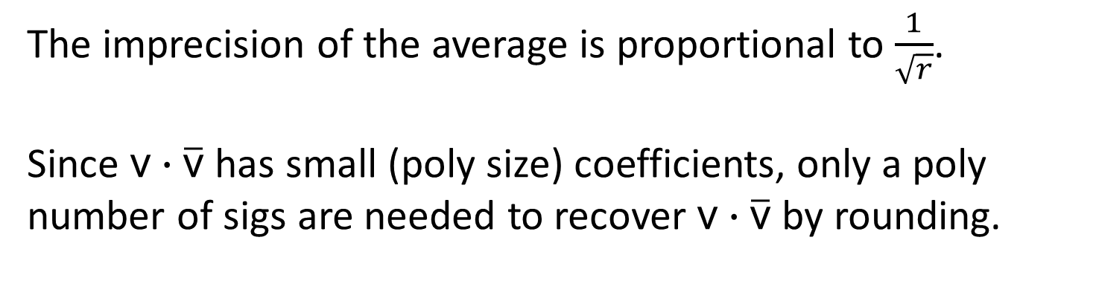
Averaging Attack
The imprecision of the average is proportional to $\frac{1}{\sqrt{r}}$.
Since $\text{v}∙\overline{\text{v}}$ has small (poly size) coefficients, only a poly number of sigs are needed to recover $\text{v}∙\overline{\text{v}}$ by rounding.

Slide 38
Finally, the “Gentry-Szydlo Algorithm”

Slide 39
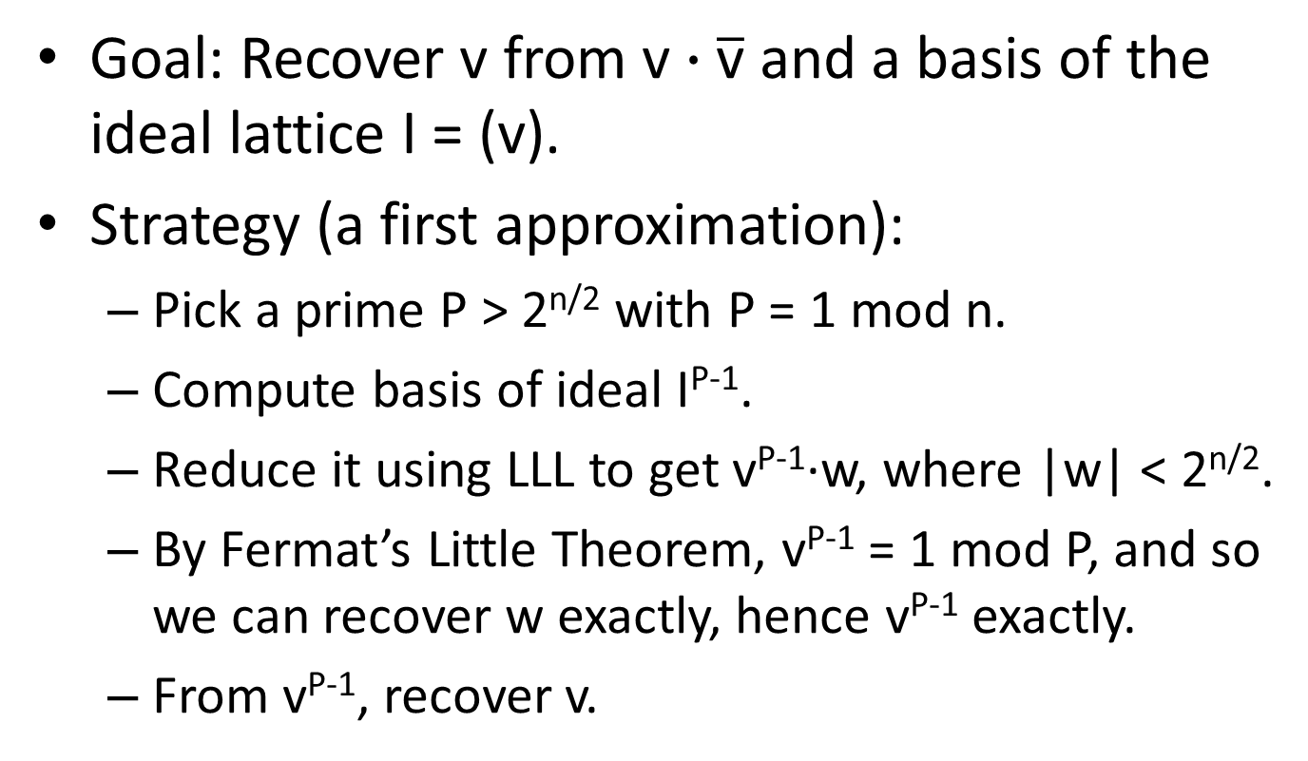
Overview of the GS Algorithm
Goal: Recover v from $\text{v}∙\overline{\text{v}}$ and a basis of the ideal lattice I = (v).
Strategy (a first approximation):
  Pick a prime P > 2^{n/2} with P = 1 mod n.
  Compute basis of ideal I^{P-1}.
  Reduce it using LLL to get v^{P-1}·w, where |w| < 2^{n/2}.
  By Fermat’s Little Theorem, v^{P-1} = 1 mod P, and so we can recover w exactly, hence v^{P-1} exactly.
  From v^{P-1}, recover v.

Slide 40
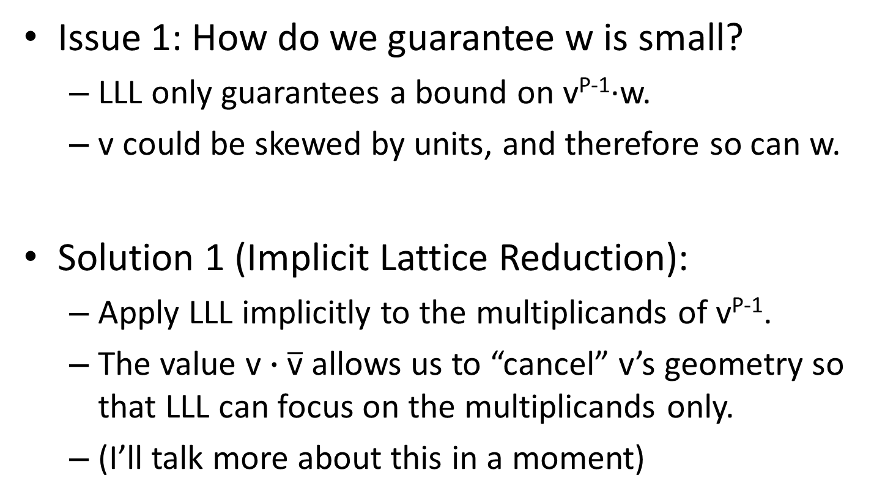
GS Overview: Issue 1
Issue 1: How do we guarantee w is small?
  LLL only guarantees a bound on v^{P-1}·w.
  v could be skewed by units, and therefore so can w.
Solution 1 (Implicit Lattice Reduction):
  Apply LLL implicitly to the multiplicands of v^{P-1}.
  The value $\text{v}∙\overline{\text{v}}$ allows us to “cancel” v’s geometry so that LLL can focus on the multiplicands only.
  (I’ll talk more about this in a moment)

Slide 41
GS Overview: Issue 2
Issue 2: LLL needs P to be exponential in n.
  But then I^{P-1} and v^{P-1} take an exponential number of bits to write down.
Solution 2 (Polynomial Chains):
  Mike will go over this, but here is a sketch…

Slide 42
Polynomial Chains (Sketch)
We do use P > 2^{n/2}, but compute v^{P-1} implicitly.
v^{P-1} and w are represented by a chain of unreduced smallish polynomials that are computed using LLL.
From the chain, we get w ← (v^{P-1}·w mod P) unreduced.
After getting w exactly, we reduce it mod some small primes p₁,…, p_{t}, and get v^{P-1} mod these primes.
Repeat for prime P’ > 2^{n/2} where gcd(P-1,P’-1) = 2n.
Compute v^{2n} = v^{gcd(P-1,P’-1)} mod the small primes.
Use CRT to recover v^{2n} exactly.
Finally, recover v.

Slide 43
Conceptual Relationship with “Coppersmith’s Method”
Find small solutions to f(x) = 0 mod N
  Construct lattice of polynomials g_{i}(x) = 0 mod N.
  LLL-reduce to obtain h(x) = 0 mod N for small h.
  h(x) = 0 mod N → h(x) = 0 (unreduced)
  Solve for x.
GS Algorithm
  Obtain v^{P-1}·w for small w.
  v^{P-1}·w = [z] mod P → w = [z] (unreduced)

Slide 44
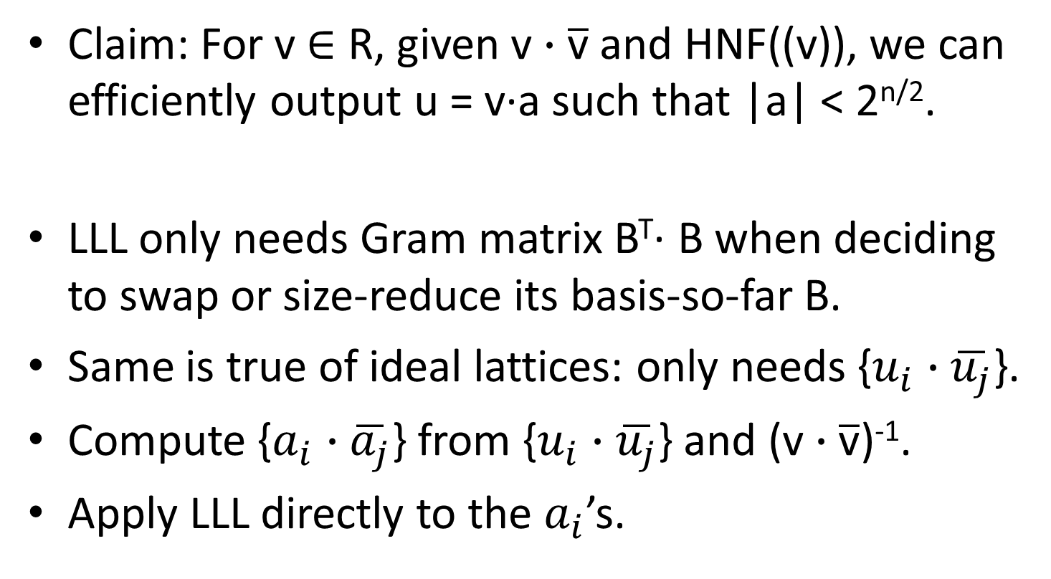
Implicit Lattice Reduction
Claim: For v $∈$ R, given $\text{v}∙\overline{\text{v}}$ and HNF((v)), we can efficiently output u = v·a such that |a| < 2^{n/2}.
LLL only needs Gram matrix B^{T}· B when deciding to swap or size-reduce its basis-so-far B.
Same is true of ideal lattices: only needs {$u_{i}$ $∙\overline{u_{j}}$}.
Compute {$a_{i}$ $∙\overline{a_{j}}$} from {$u_{i}$ $∙\overline{u_{j}}$} and ($\text{v}∙\overline{\text{v}}$)⁻¹.
Apply LLL directly to the $a_{i}$’s.

Slide 45
A Possible Simplication of GS?

Slide 46
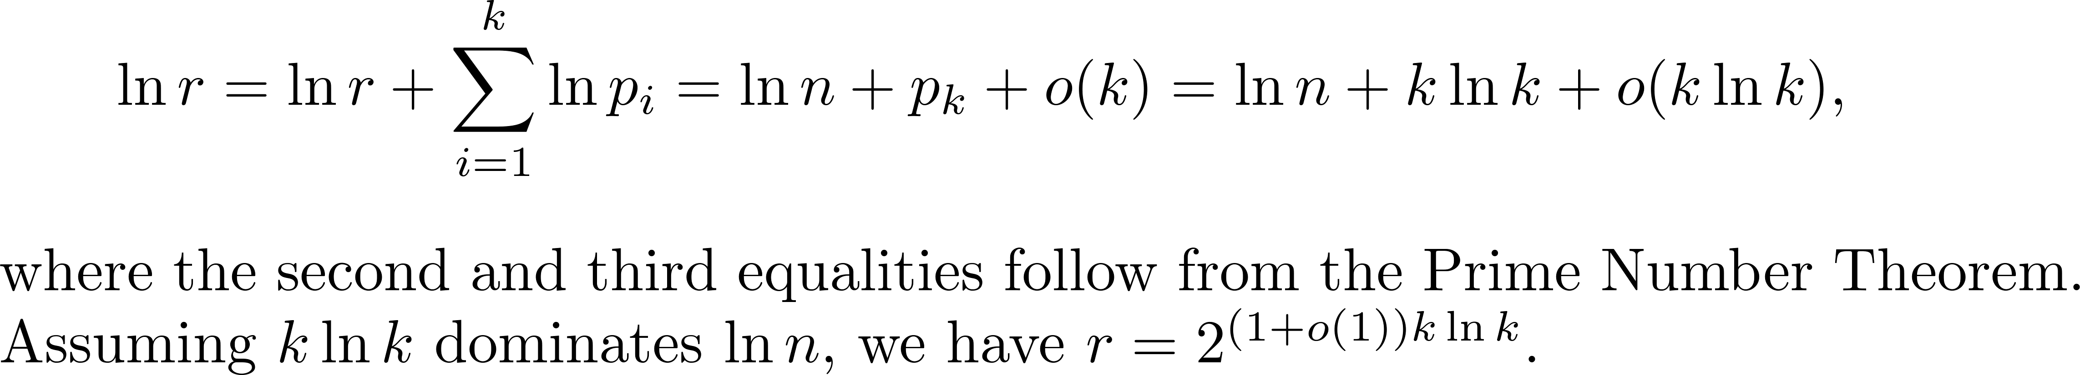
Can We Avoid Polynomial Chains?
If v^{r} = 1 mod Q for small r and composite Q > 2^{n/2}, maybe it still works and we can write v^{r} down.
Set r = n·Πp_{i}, where p_{i} runs over first k primes.
  Suppose k = O(log n).
Set Q = ΠP such P-1 divides r. Note: v^{r} = 1 mod Q.

Slide 47
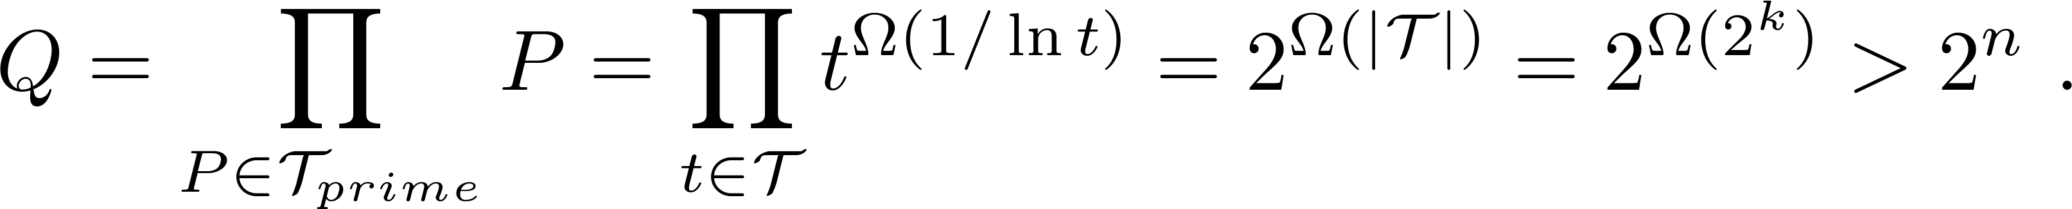
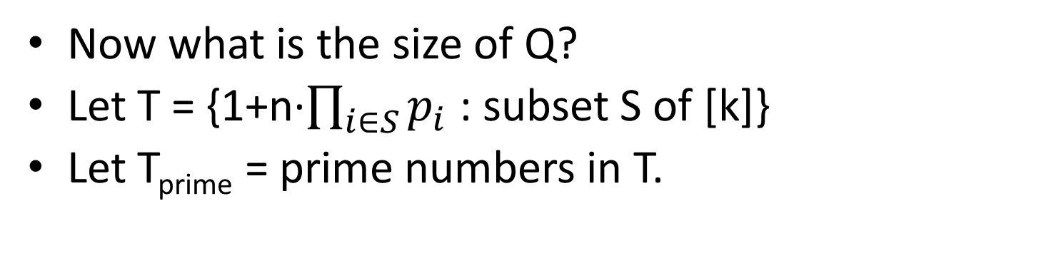
Can We Avoid Polynomial Chains?
Now what is the size of Q?
Let T = {1+n·$\prod_{i∈S}{p_{i}}$ : subset S of [k]}
Let T_{prime} = prime numbers in T.

Slide 48
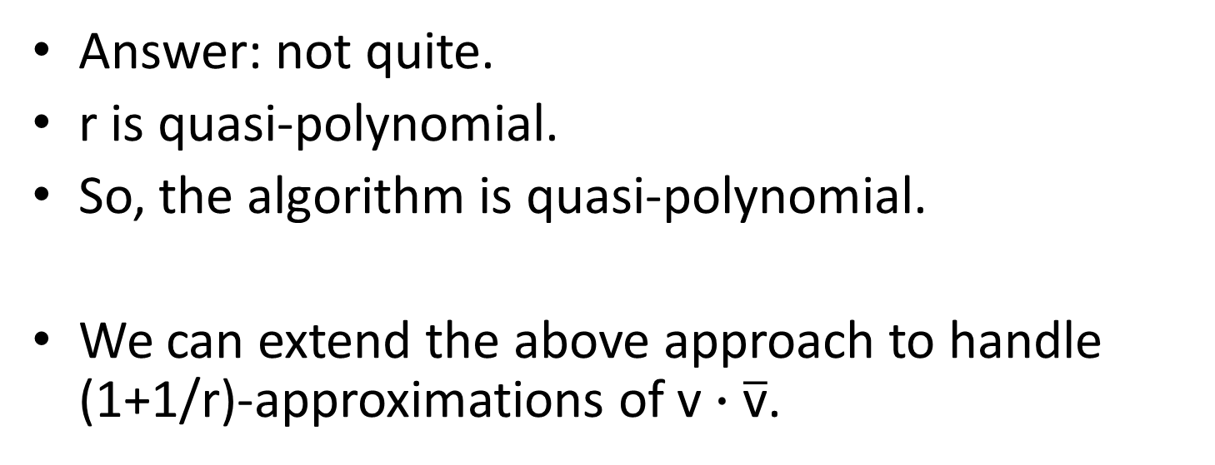
Can We Avoid Polynomial Chains?
Answer: not quite.
r is quasi-polynomial.
So, the algorithm is quasi-polynomial.
We can extend the above approach to handle (1+1/r)-approximations of $\text{v}∙\overline{\text{v}}$.

Slide 49
GS Makes
Principal Ideal Lattices Weak

Slide 50
Dimension-Halving in Principal Ideal Lattices
For any n-dim principal ideal lattice I = (v):
Solving 2-approximate SVP in I
< Solving SVP in some n/2-dim lattice.
“Breaking” principal ideal lattices seems easier than breaking general ideal lattices.
Attack uses GS algorithm
A

Slide 51
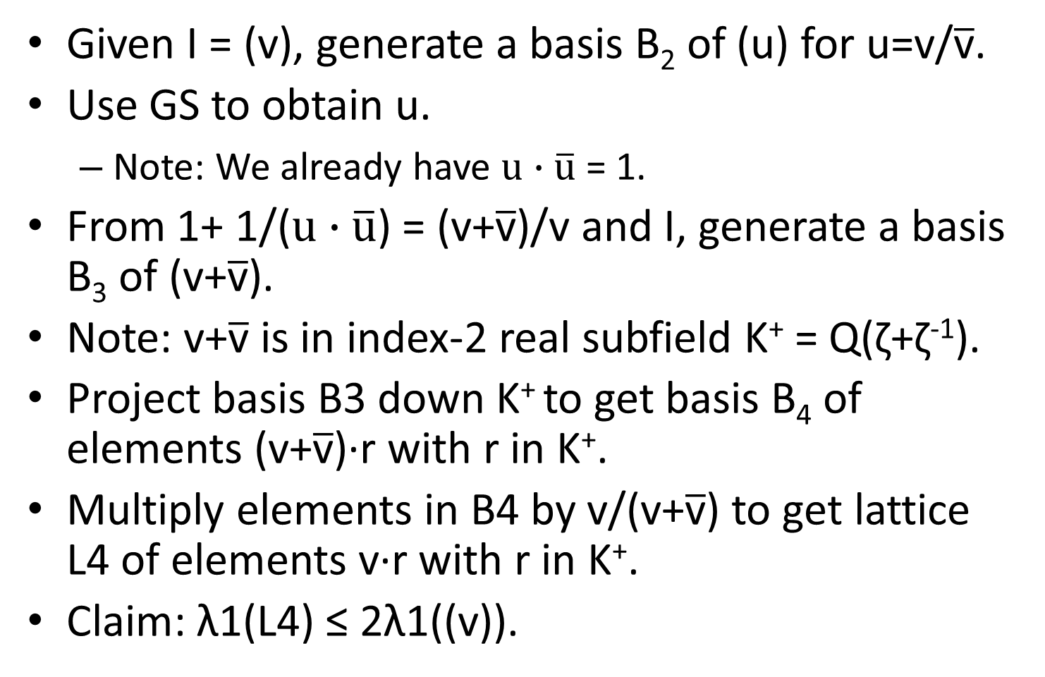
Dimension-Halving in Principal Ideal Lattices
Given I = (v), generate a basis B₂ of (u) for u=v/$\overline{\text{v}}$.
Use GS to obtain u.
  Note: We already have $u∙\overline{\text{u}}$ = 1.
From 1+ 1/($u∙\overline{\text{u}}$) = (v+$\overline{\text{v}}$)/v and I, generate a basis B₃ of (v+$\overline{\text{v}}$).
Note: v+$\overline{\text{v}}$ is in index-2 real subfield K⁺ = Q(ζ+ζ⁻¹).
Project basis B3 down K⁺ to get basis B₄ of elements (v+$\overline{\text{v}}$)·r with r in K⁺.
Multiply elements in B4 by v/(v+$\overline{\text{v}}$) to get lattice L4 of elements v·r with r in K⁺.
Claim: λ1(L4) ≤ 2λ1((v)).

Slide 52
Thanks! Questions?
TIME
EXPIRED
?
?

Slide 53
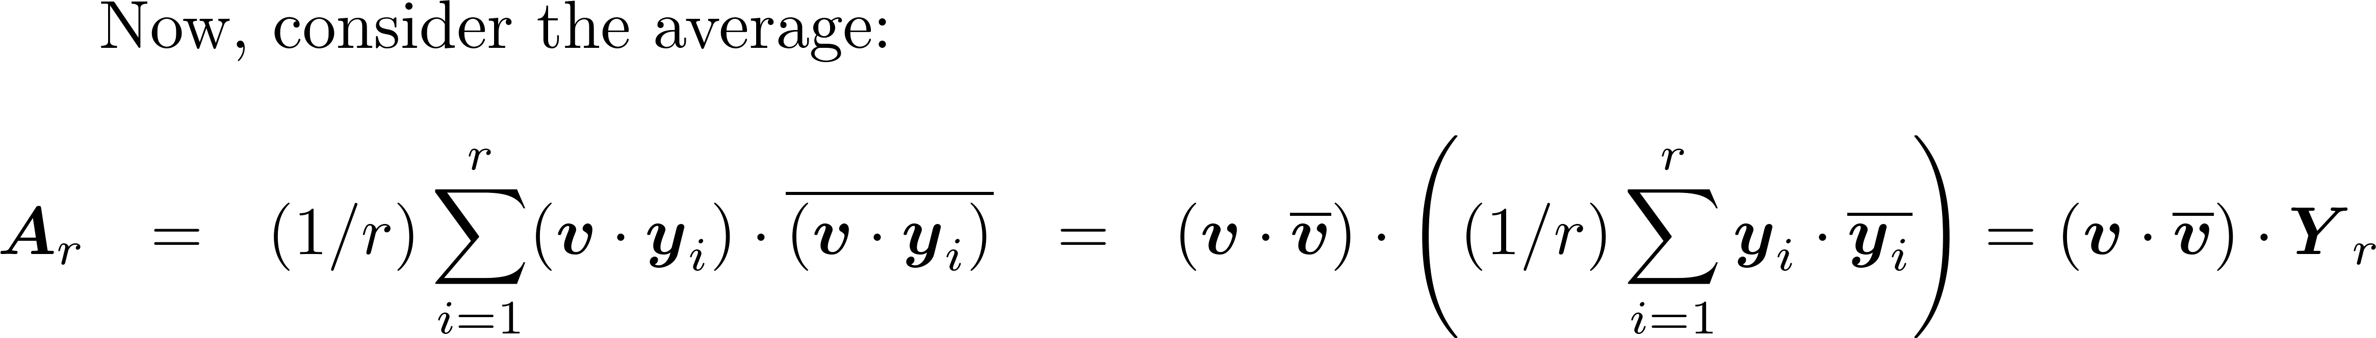
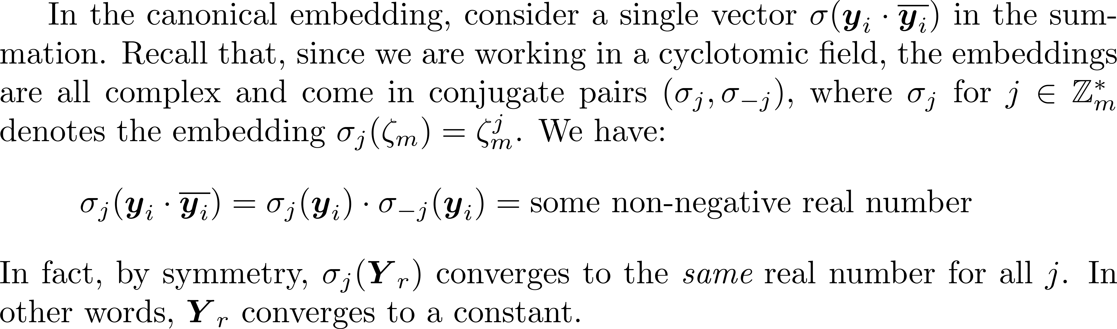
Averaging Attack

Slide 54
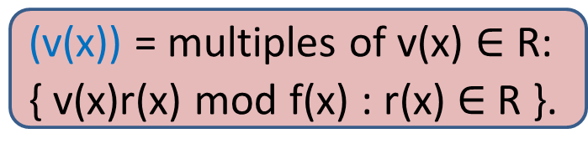
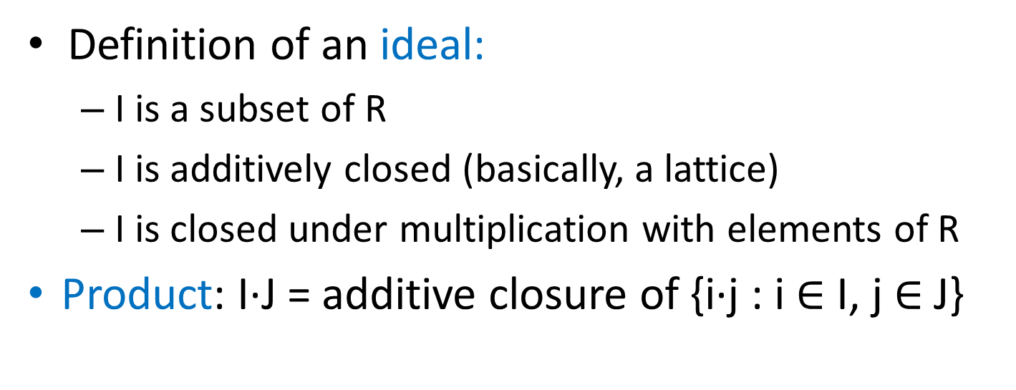
Ideal Lattices
Definition of an ideal:
  I is a subset of R
  I is additively closed (basically, a lattice)
  I is closed under multiplication with elements of R
Product: I∙J = additive closure of {i∙j : i $∈$ I, j $∈$J}
(3) = polynomials in R that are divisible by 3
(v(x)) = multiples of v(x) $∈$R:
{ v(x)r(x) mod f(x) : r(x) $∈$ R }.

Slide 55

Ideal Lattices
Definition of an ideal:
  I is a subset of R
  I is additively closed (basically, a lattice)
  I is closed under multiplication with elements of R
(3) = polynomials in R that are divisible by 3
(v(x)) = multiples of v(x) $∈$R:
{ v(x)r(x) mod f(x) : r(x) $∈$ R }.

Slide 56
Ideal Lattice
Ideal lattice: a representation of an ideal as a free Z-module (a lattice) of rank n generated by some n-dimensional basis B.

Slide 57
Principal Ideal Generator Problem
PIG Problem: Given an ideal lattice L of a principal ideal I, output v such that I = (v).

Slide 58
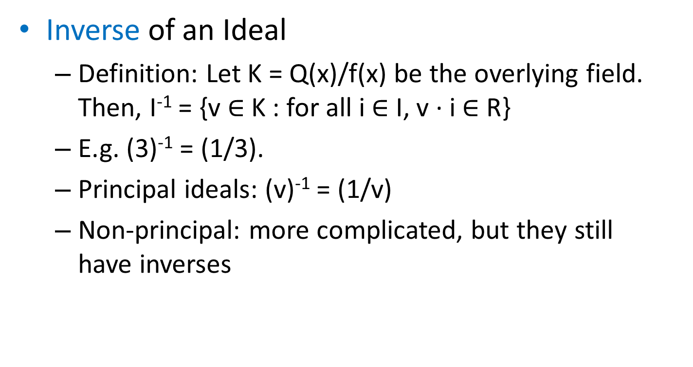
Ideals in Polynomial Rings
Inverse of an Ideal
  Definition: Let K = Q(x)/f(x) be the overlying field. Then, I⁻¹ = {v $∈$ K : for all i $∈$ I, v ∙ i $∈$ R}
  E.g. (3)⁻¹ = (1/3).
  Principal ideals: (v)⁻¹ = (1/v)
  Non-principal: more complicated, but they still have inverses

Slide 59
Ideals Are Like Integers
Norm: Nm(I) = |R/I| = determinant of basis of I
  Norm map is multiplicative: Nm(I∙J) = Nm(I)∙Nm(J)
Primality: I is prime if I dividing JK implies I divides J or I divides K
  Prime ideals have norm that is a prime power
Unique factorization: Each ideal I of R = Z[x]/(x^{n}+1)) factors uniquely into prime ideals
Prime Ideal Theorem (cf. Prime Number Th.):
  # of prime ideals with norm ≤ x is close to x/ln(x)

Slide 60
Ideals Are Like Integers
Factoring ideals reduces to factoring integers
  Kummer-Dedekind:
    Consider the factorization of f(x) = ∏_{i} g_{i}(x) mod p.
    In Z[x]/f(x), the prime ideal factors p_{i} whose norm are a power of p are precisely: p_{i} = (p, g_{i}(x))
  Polynomial factorization mod p
    Is efficient (e.g., Kaltofen-Shoup algorithm)
  Bottom line: We can factor I if we can factor Nm(I)

Slide 61
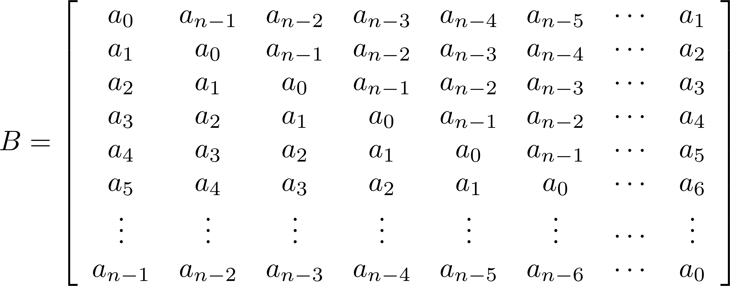
Dimension-Halving Attack on Circulant Bases

Slide 62
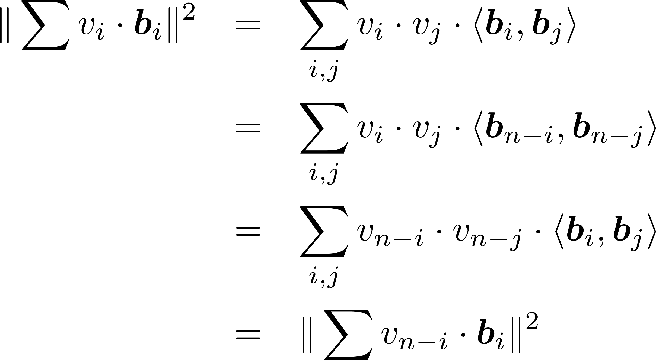
Dimension-Halving Attack on Circulant Bases

Slide 63
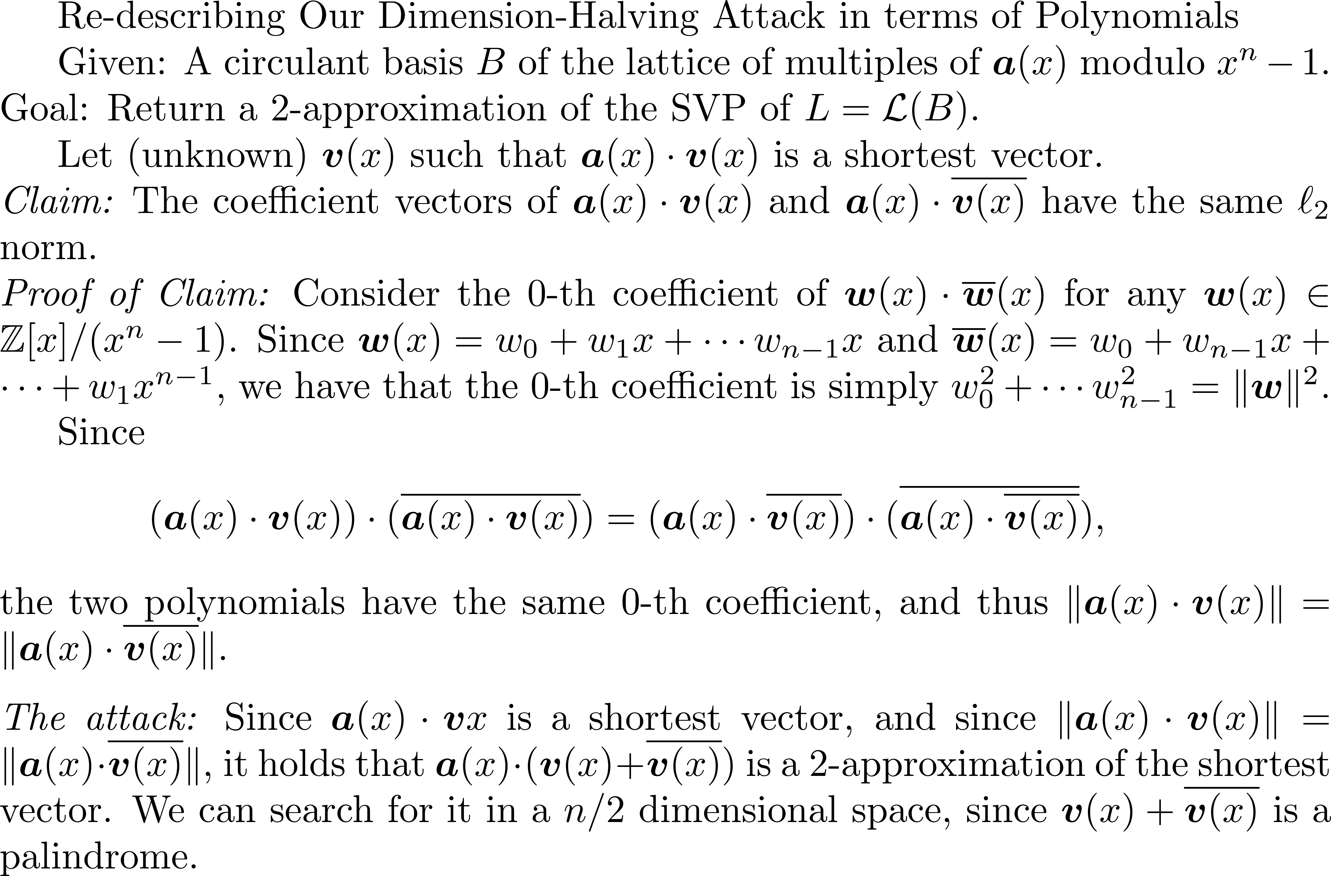

Slide 64
More Algebra

Slide 65
Why lattices are cool for crypto/ Context
No quantum attacks on lattices
  in contrast to RSA, elliptic curves, …
Worst-case / average-case connection
  Ajtai (‘96): solving average instances of some lattice problem implies solving worst-case instances of some lattice problem

Slide 66
Dimension-Halving for Principal Ideal Lattices
[GS’02]: Given
  a basis of I = (u) for u(x) 2 R and
  u’s relative norm u(x)ū(x) in the index-2 subfield Q(ζ_{N}+ ζ_{N}⁻¹),
  we can compute u(x) in poly-time.
Corollary: Set v(x) = u(x)/ū(x). We can compute v(x) given a basis of J = (v).
  We know v(x)’s relative norm equal 1.

Slide 67
Dimension-Halving for Principal Ideal Lattices
Attack given a basis of I = (u):
  First, compute v(x) = u(x)/ū(x).
  Given a basis {u(x)r_{i}(x)} of I, multiply by 1+1/v(x) to get a basis {(u(x)+ ū(x))r_{i}(x)} of K = (u(x)+ū(x)) over R.
  Intersect K’s lattice with subring R’ = Z[ζ_{N}+ ζ_{N}⁻¹] to get a basis {(u(x)+ ū(x))s_{i}(x) : s_{i}(x) 2 R’} of K over R’.
  Apply lattice reduction to lattice {u(x)s_{i}(x) : s_{i}(x) 2 R’}, which has half the usual dimension.

Slide 68
Before Step 3:
An Geometric Interlude
(Implicit Lattice Reduction)

Slide 70
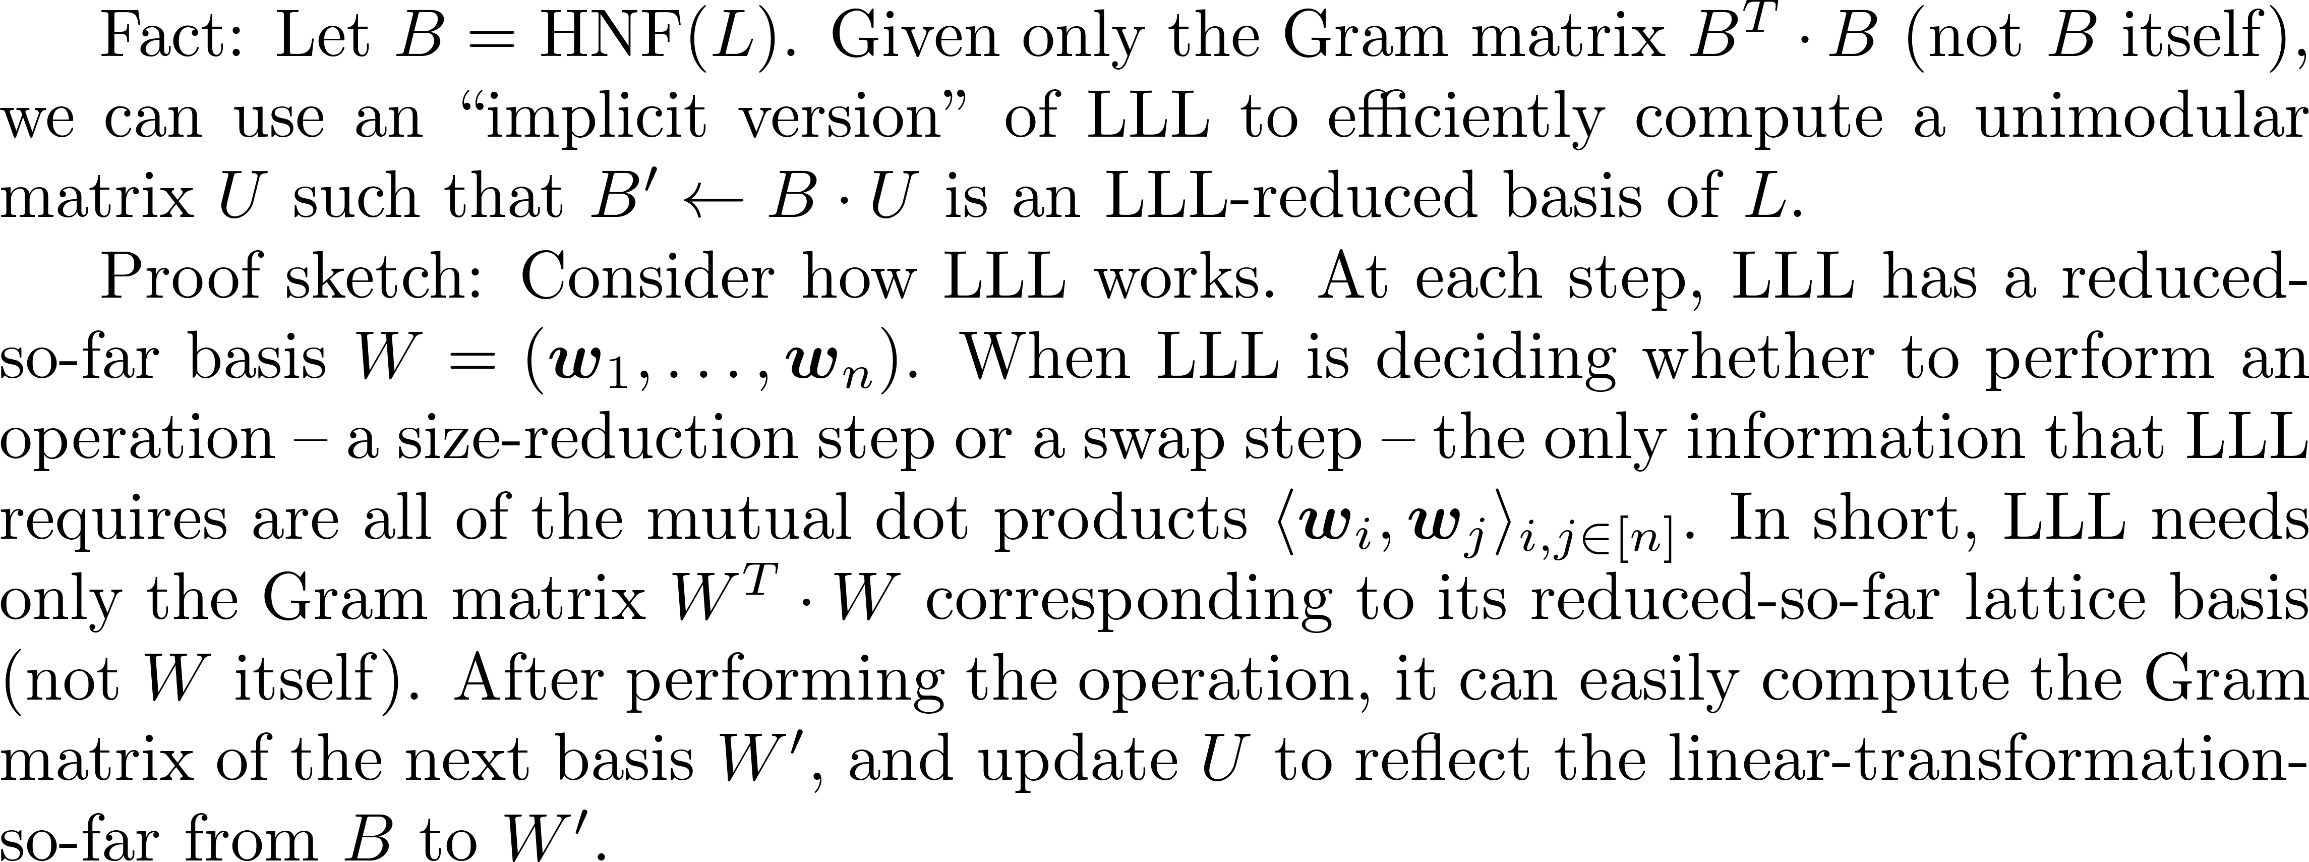
Implicit Lattice Reduction

Slide 71
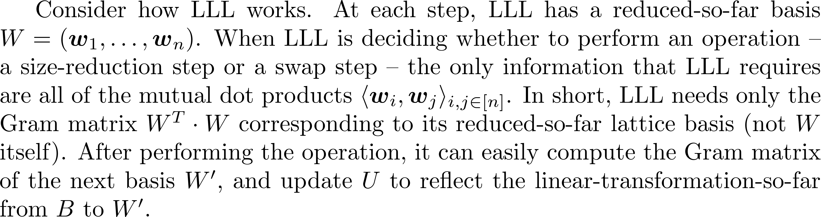
Implicit Lattice Reduction

Slide 72
Before Step 3:
An Algebraic Interlude

